Slide 1
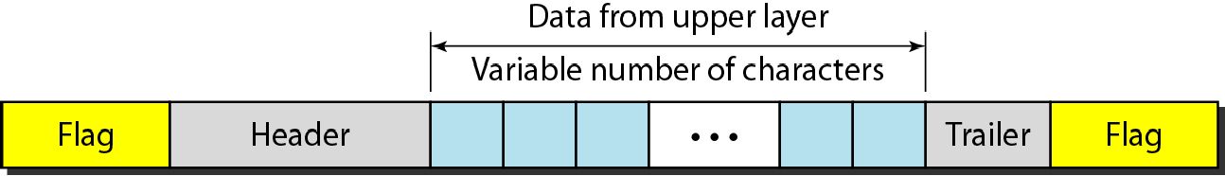
11-1 FRAMING
The data link layer needs to pack bits into frames,, so that each frame is distinguishable from another.... Our postal system practices a type of framing. The simple act of inserting a letter into an envelope separates one piece of information from another; the envelope serves as the delimiter..
Topics discussed in this section:
Fixed-Size Framing Variable-Size Framing
Figure 11.1 A frame in a character-oriented protocol
11.1

Slide 2
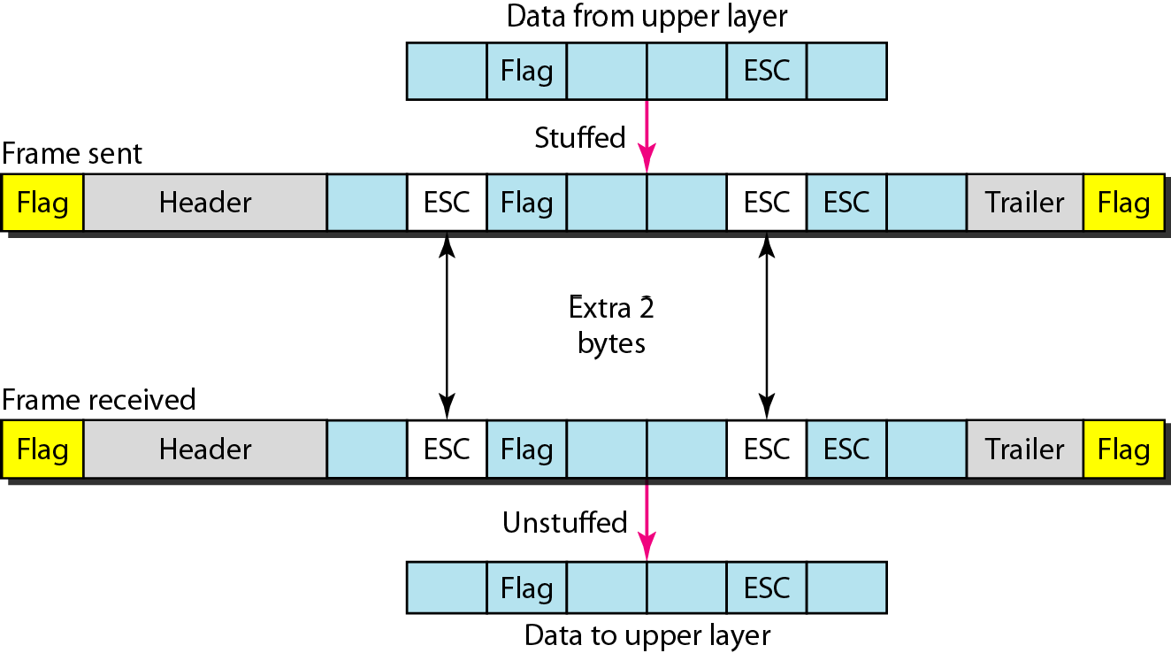
Figure 11.2 Byte stuffing and unstuffing
11.2

Slide 3
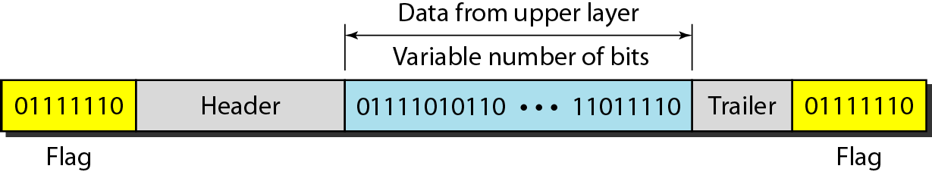
Figure 11.3 A frame in a bit-oriented protocol
Byte stuffing is the process of adding 1 extra byte whenever there is a flag or escape character in the text.
Bit stuffing is the process of adding one extra 0 whenever five consecutive 1s follow a 0 in the data, so that the receiver does not mistake
the pattern 0111110 for a flag.
11.3

Slide 4
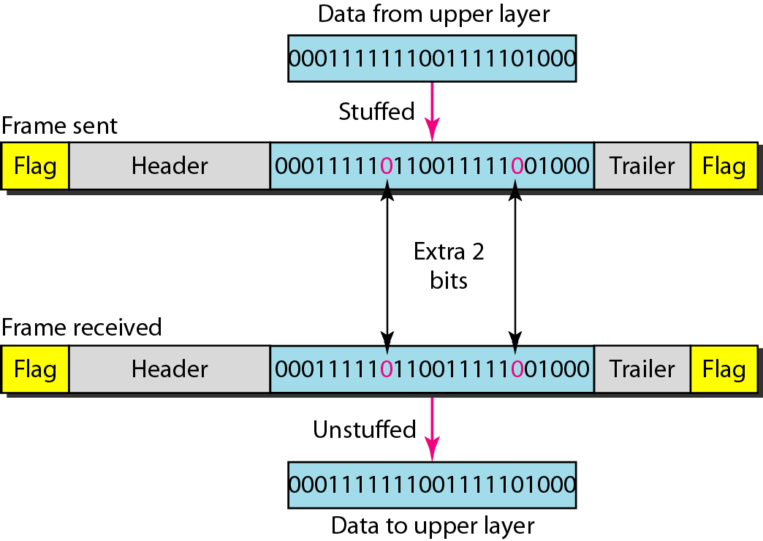
Figure 11.4 Bit stuffing and unstuffing
11.4

Slide 5
Flow control refers to a set of procedures used to restrict the amount of data
that the sender can send before waiting for acknowledgment.
Error control in the data link layer is based on automatic repeat request, which is the retransmission of data.

Slide 6
11-3 PROTOCOLS
Now let us see how the data link layer can combine framing, flow control, and error control to achieve the delivery of data from one node to another.. The protocols are normally implemented in software by using one of the common programming languages.. To make our discussions language-free, we have written in pseudocode a version of each protocol that concentrates mostly on the procedure instead of delving into the details of language rules..

Slide 7
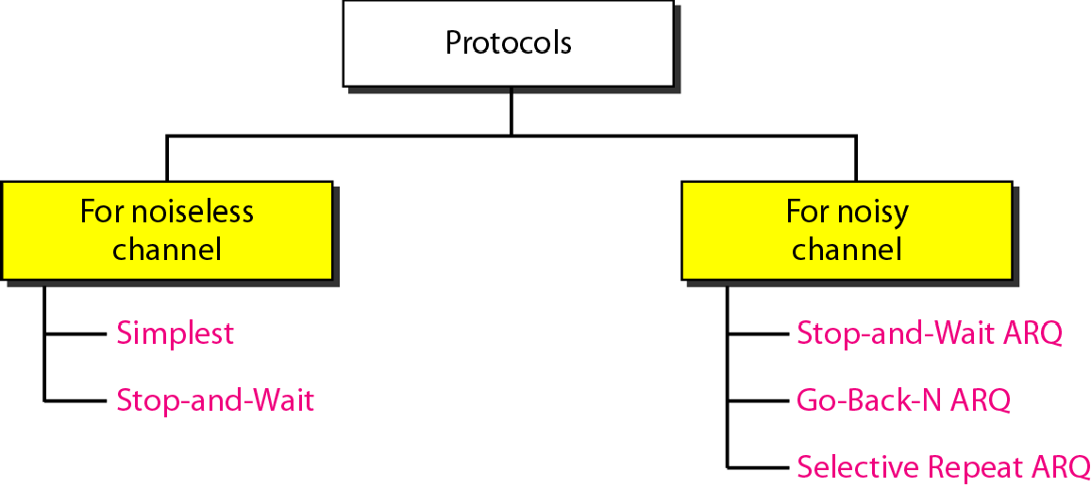
Figure 11.5 Taxonomy of protocols discussed in this chapter

Slide 8
11-4 NOISELESS CHANNELS
Let us first assume we have an ideal channel in which no frames are lost, duplicated, or corrupted. We introduce two protocols for this type of channel..
Topics discussed in this section:
Simplest Protocol
Stop-and-Wait Protocol

Slide 9
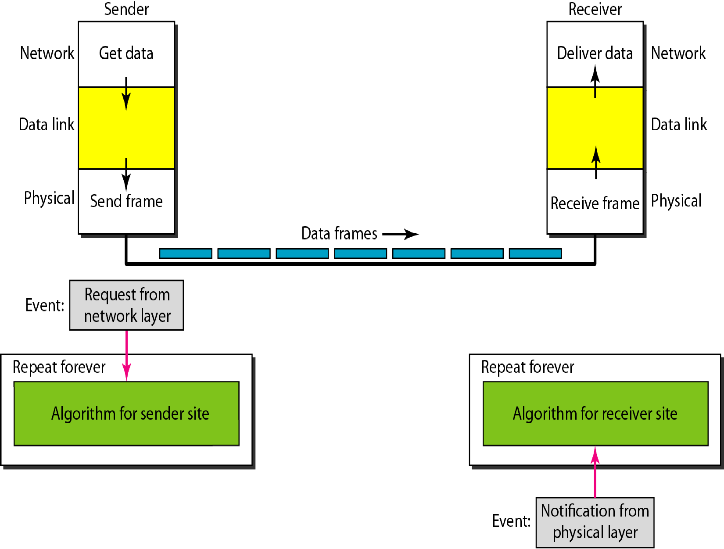
Figure 11.6 The design of the simplest protocol with no flow or error control

Slide 10
Example 11.1
Figure 11.7 shows an example of communication using this protocol. It is very simple. The sender sends a sequence of frames without even thinking about the receiver. To send three frames, three events occur at the sender site and three events at the receiver site. Note that the data frames are shown by tilted boxes; the height of the box defines the transmission time difference between the first bit and the last bit in the frame.

Slide 11
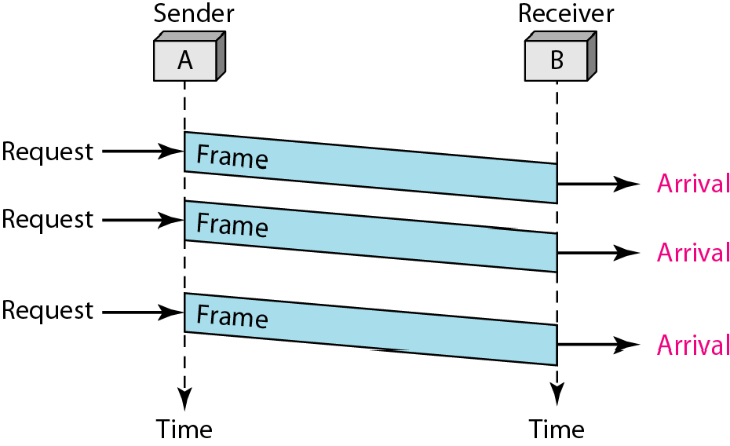
Figure 11.7 Flow diagram for Example 11.1

Slide 12
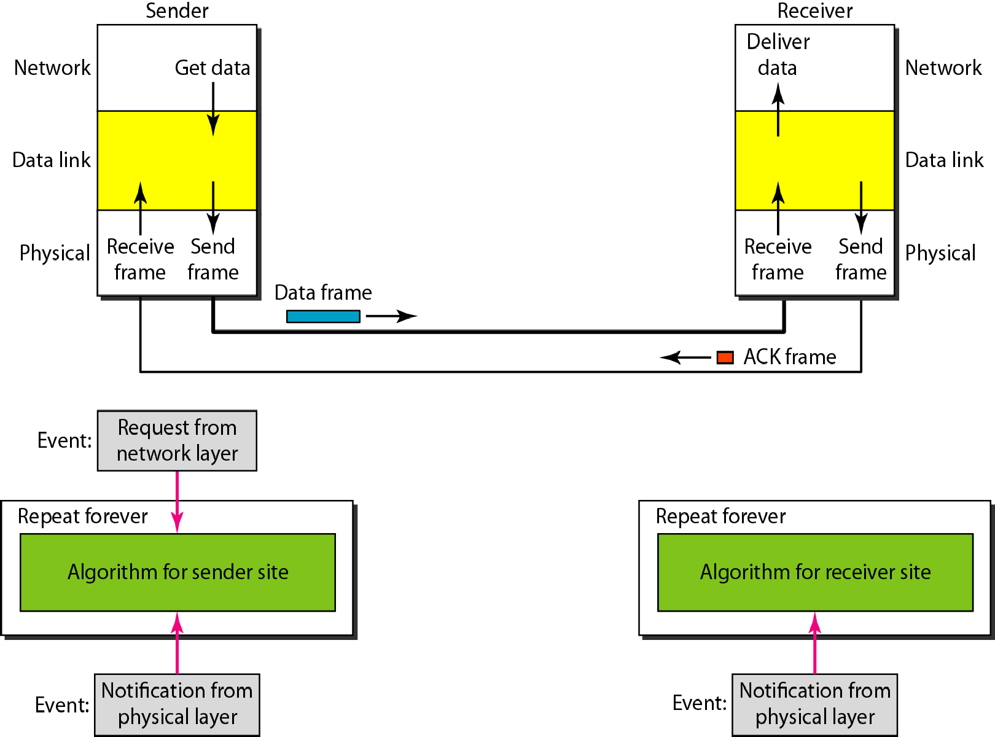
Figure 11.8 Design of Stop-and-Wait Protocol

Slide 13
Example 11.2
Figure 11.9 shows an example of communication using this protocol. It is still very simple. The sender sends one frame and waits for feedback from the receiver. When the ACK arrives, the sender sends the next frame. Note that sending two frames in the protocol involves the sender in four events and the receiver in two events.

Slide 14
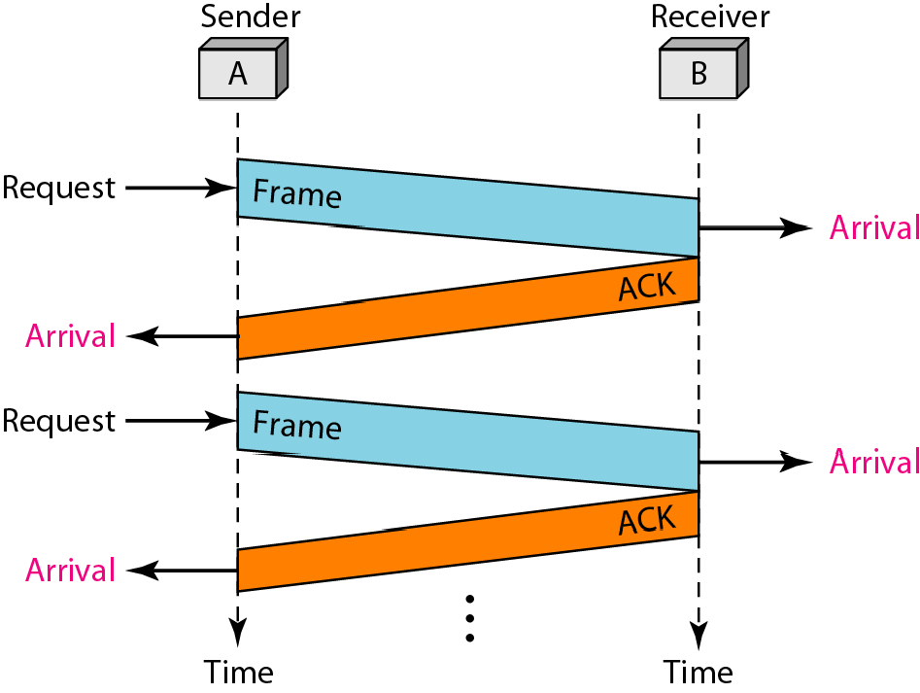
Figure 11.9 Flow diagram for Example 11.2

Slide 15
11-5 NOISY CHANNELS
Although the Stop-and-Wait Protocol gives us an idea of how to add flow control to its predecessor, noiseless channels are nonexistent.. We discuss three protocols in this section that use error control.
Topics discussed in this section:
Stop-and-Wait Automatic Repeat Request Go-Back-N Automatic Repeat Request Selective Repeat Automatic Repeat Request

Slide 16
Error correction in Stop-and-Wait ARQ is done by keeping a copy of the sent frame and retransmitting of the frame when the timer expires.
In Stop-and-Wait ARQ, we use sequence numbers to number the frames. The sequence numbers are based on modulo-2 arithmetic.
In Stop-and-Wait ARQ, the acknowledgment number always announces in modulo-2 arithmetic the sequence number of the next frame expected.

Slide 17
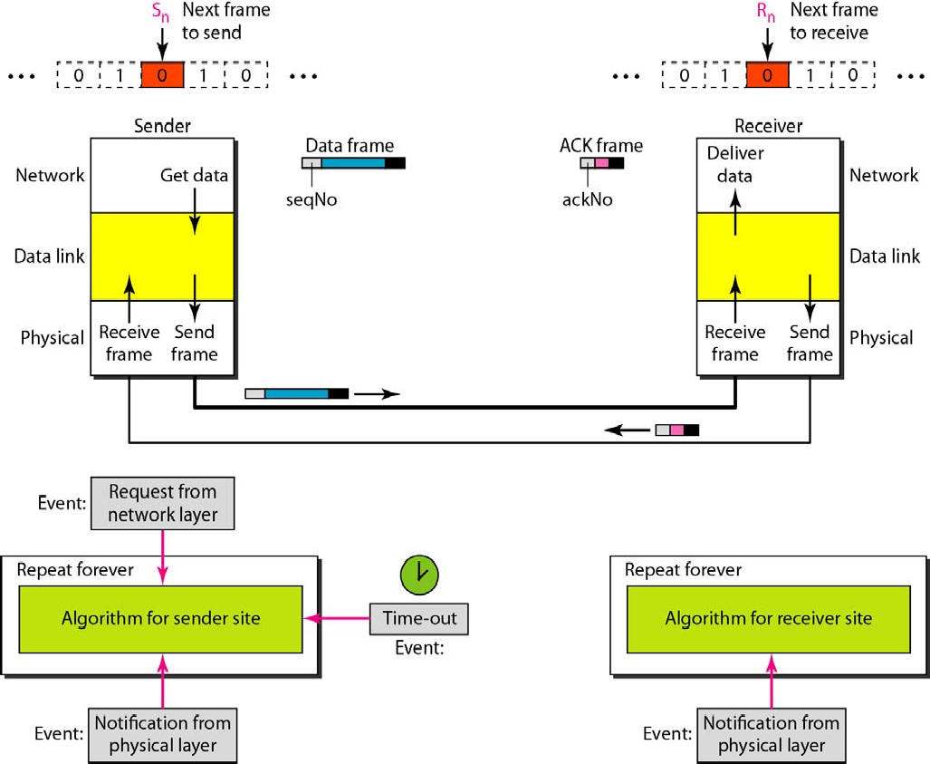
Figure 11.10 Design of the Stop-and-Wait ARQ Protocol

Slide 18
Example 11.3
Figure 11.11 shows an example of Stop-and-Wait ARQ. Frame 0 is sent and acknowledged. Frame 1 is lost and resent after the time-out. The resent frame 1 is acknowledged and the timer stops. Frame 0 is sent and acknowledged, but the acknowledgment is lost. The sender has no idea if the frame or the acknowledgment is lost, so after the time-out, it resends frame 0, which is acknowledged.

Slide 19
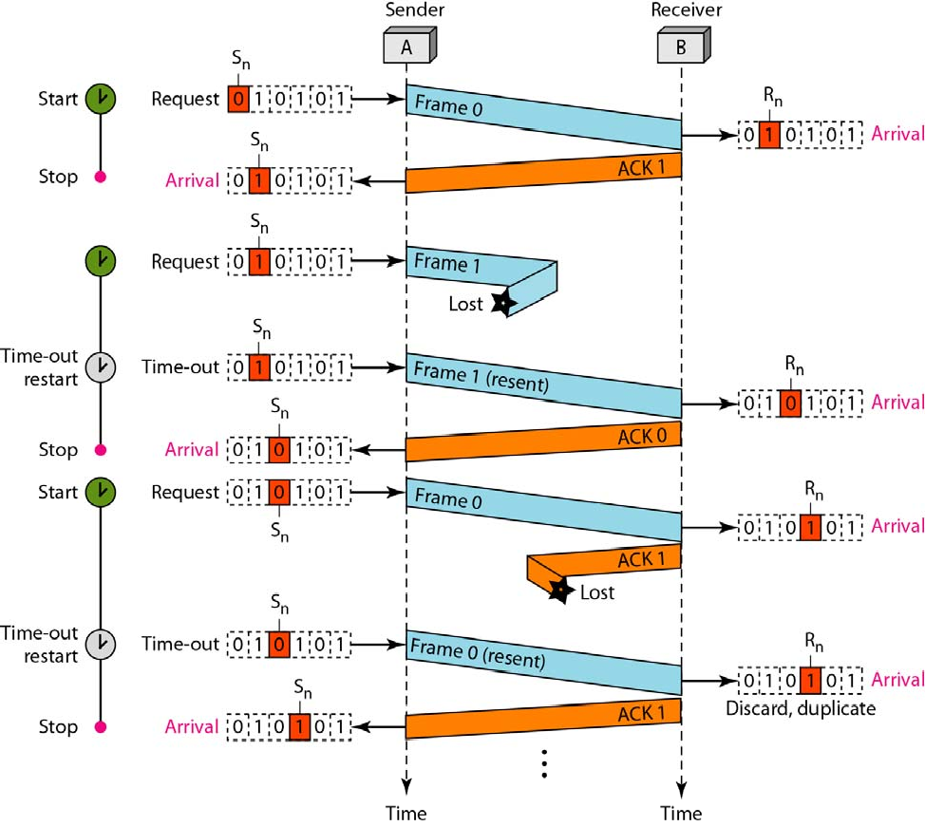
Figure 11.11 Flow diagram for Example 11.3

Slide 20

Example 11.4
Assume that, in a Stop-and-Wait ARQ system, the bandwidth of the line is 1 Mbps, and 1 bit takes 20 ms to make a round trip. What is the bandwidth-delay product? If the system data frames are 1000 bits in length, what is the utilization percentage of the link?
Solution
The bandwidth-delay product is

Slide 21
Example 11.4 (continued)
The system can send 20,000 bits during the time it takes for the data to go from the sender to the receiver and then back again. However, the system sends only 1000 bits. We can say that the link utilization is only 1000/20,000, or 5 percent. For this reason, for a link with a high bandwidth or long delay, the use of Stop-and-Wait ARQ wastes the capacity of the link.

Slide 22
Example 11.5
What is the utilization percentage of the link in Example 11 4 if we have a protocol that can send up to
15 frames before stopping and worrying about the acknowledgments?
Solution
The bandwidth-delay product is still 20,000 bits. The system can send up to 15 frames or 15,000 bits during a round trip. This means the utilization is 15,000/20,000, or 75 percent. Of course, if there are damaged frames, the utilization percentage is much less because frames have to be resent.
In the Go-Back-N Protocol, the sequence numbers are modulo 2^{m}, where m is the size of the sequence number field in bits.

Slide 23
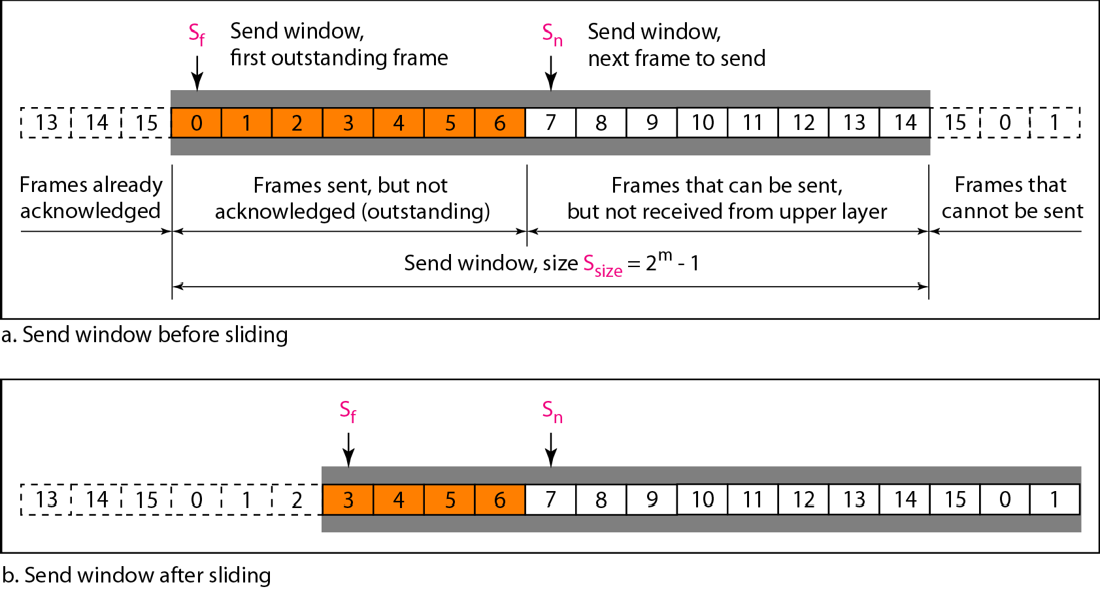
Figure 11.12 Send window for Go-Back-N ARQ

Slide 24
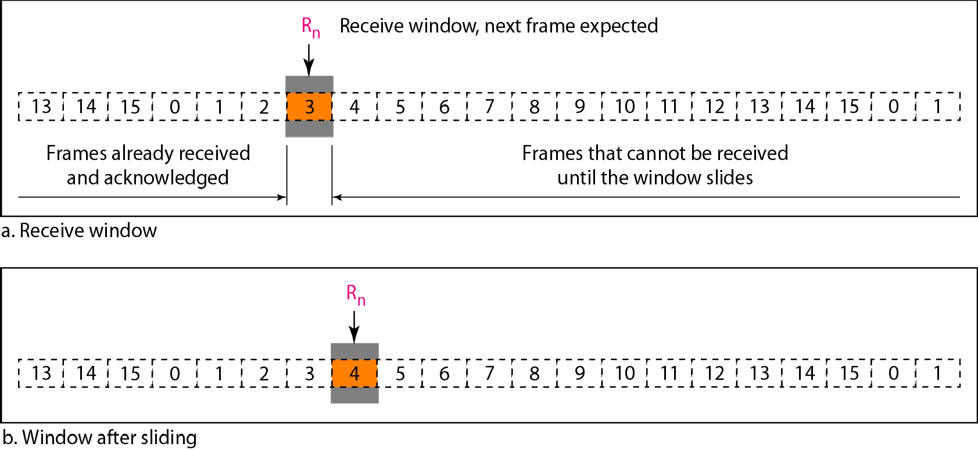
Figure 11.13 Receive window for Go-Back-N ARQ
The send window is an abstract concept defining an imaginary box of size 2^{m} − 1 with three variables: S_{f}, S_{n}, and S_{size}.
The send window can slide one or more slots when a valid acknowledgment arrives.

Slide 25

Note
The receive window is an abstract concept defining an imaginary box of size 1 with one single variable R_{n}.
The window slides
when a correct frame has arrived; sliding occurs one slot at a time.

Slide 26
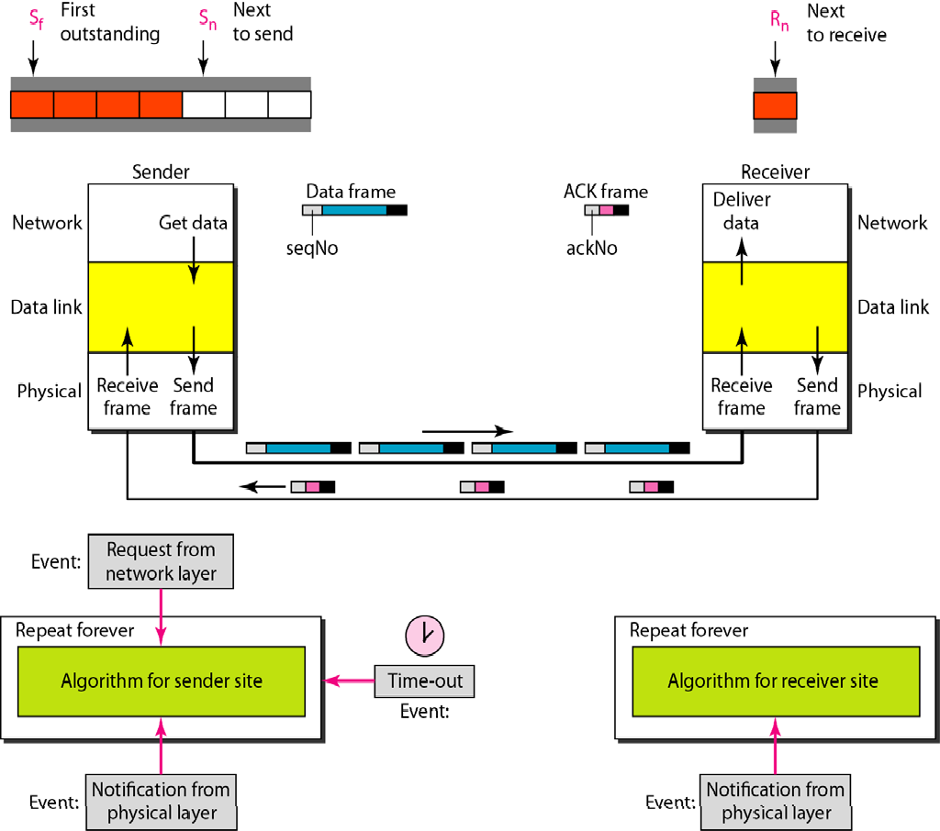
Figure 11.14 Design of Go-Back-N ARQ

Slide 27
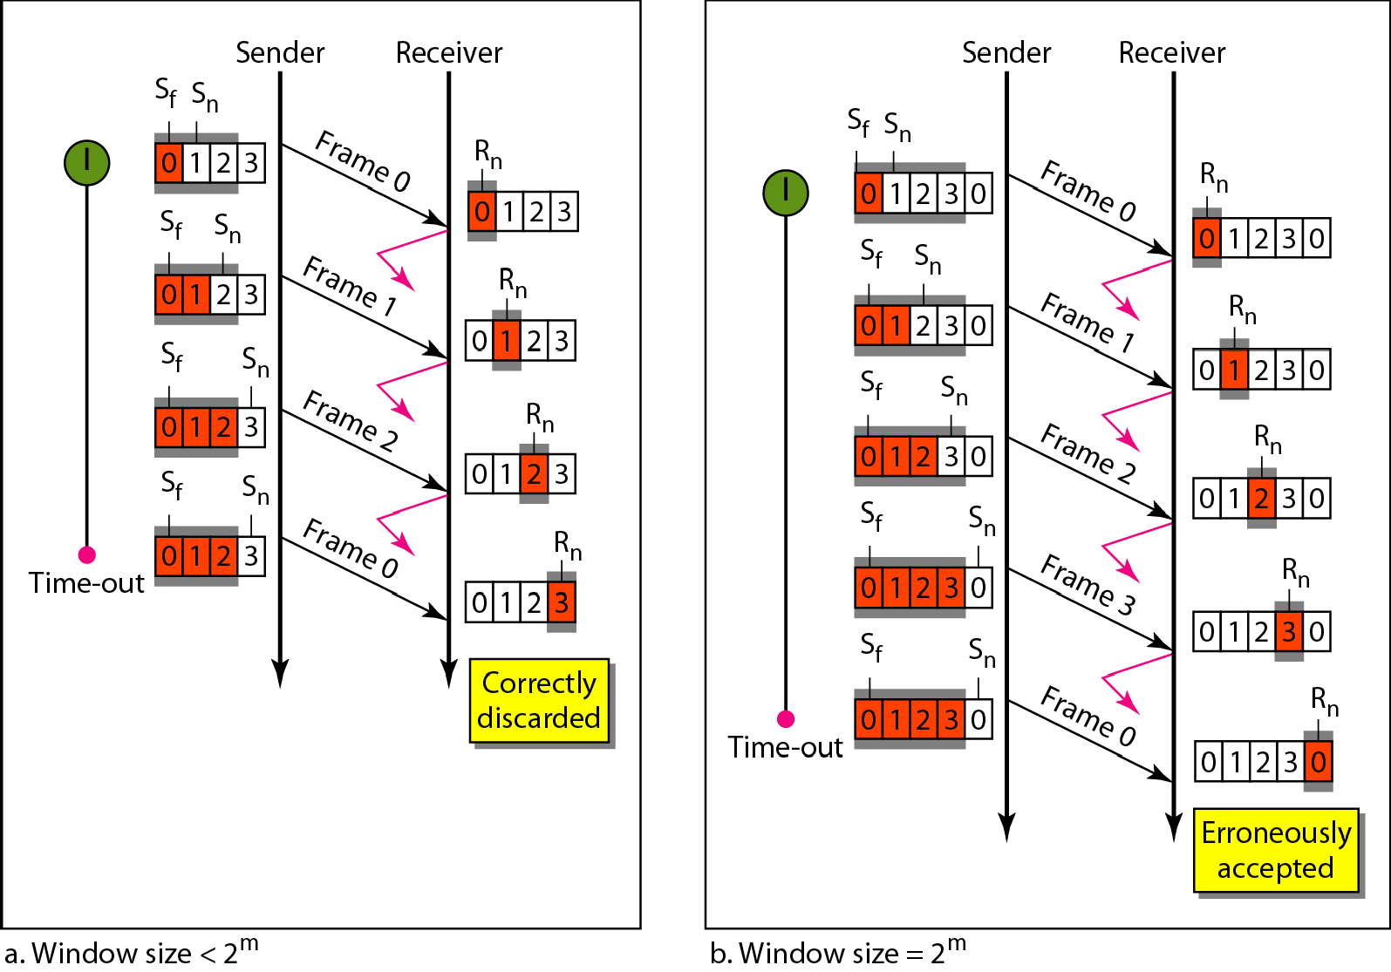
Figure 11.15 Window size for Go-Back-N ARQ

Slide 28

Note
In Go-Back-N ARQ, the size of the send window must be less than 2^{m};
the size of the receiver window is always 1.

Slide 29
Example 11.6
Figure 11.16 shows an example of Go-Back-N. This is an example of a case where the forward channel is reliable, but the reverse is not. No data frames are lost, but some ACKs are delayed and one is lost. The example also shows how cumulative acknowledgments can help if acknowledgments are delayed or lost. After initialization, there are seven sender events. Request events are triggered by data from the network layer; arrival events are triggered by acknowledgments from the physical layer. There is no time-out event here because all outstanding frames are acknowledged before the timer expires. Note that although ACK 2 is lost, ACK 3 serves as both ACK 2 and ACK 3.

Slide 30
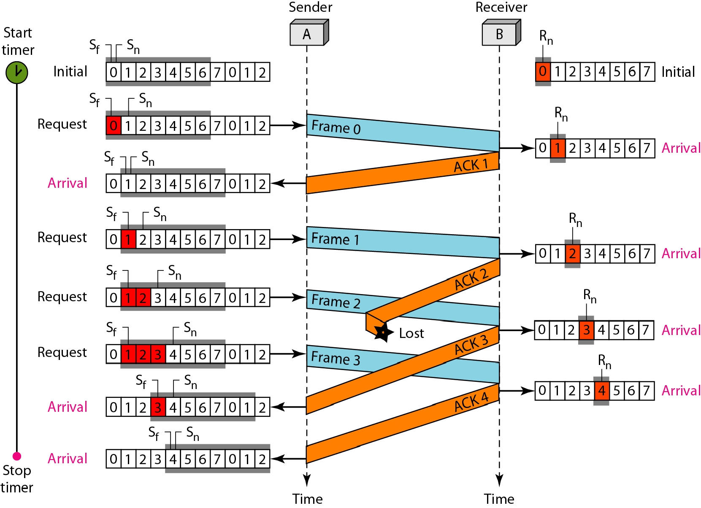
Figure 11.16 Flow diagram for Example 11.6

Slide 31
Example 11.7
Figure 11.17 shows what happens when a frame is lost. Frames 0, 1, 2, and 3 are sent However, frame 1 is lost The receiver receives frames 2 and 3, but they are discarded because they are received out of order The sender receives no acknowledgment about frames 1, 2, or
3 Its timer finally expires The sender sends all outstanding frames (1, 2, and 3) because it does not know what is wrong Note that the resending of frames 1, 2, and 3 is the response to one single event. When the sender is responding to this event, it cannot accept the triggering of other events. This means that when ACK 2 arrives, the sender is still busy with sending frame 3

Slide 32
Example 11.7 (continued)
The physical layer must wait until this event is completed and the data link layer goes back to its sleeping state. We have shown a vertical line to indicate the delay. It is the same story with ACK 3; but when ACK 3 arrives, the sender is busy responding to ACK 2. It happens again when ACK 4 arrives. Note that before the second timer expires, all outstanding frames have been sent and the timer is stopped.

Slide 33
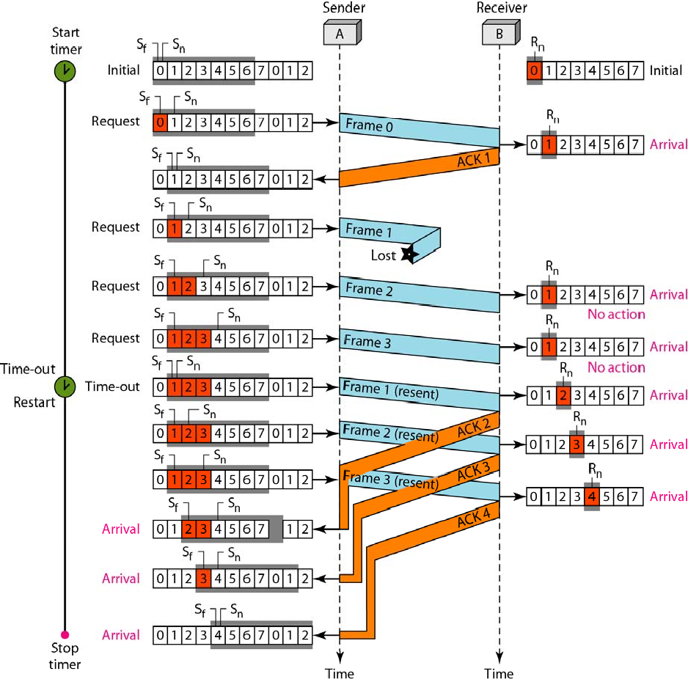
Figure 11.17 Flow diagram for Example 11.7

Slide 34
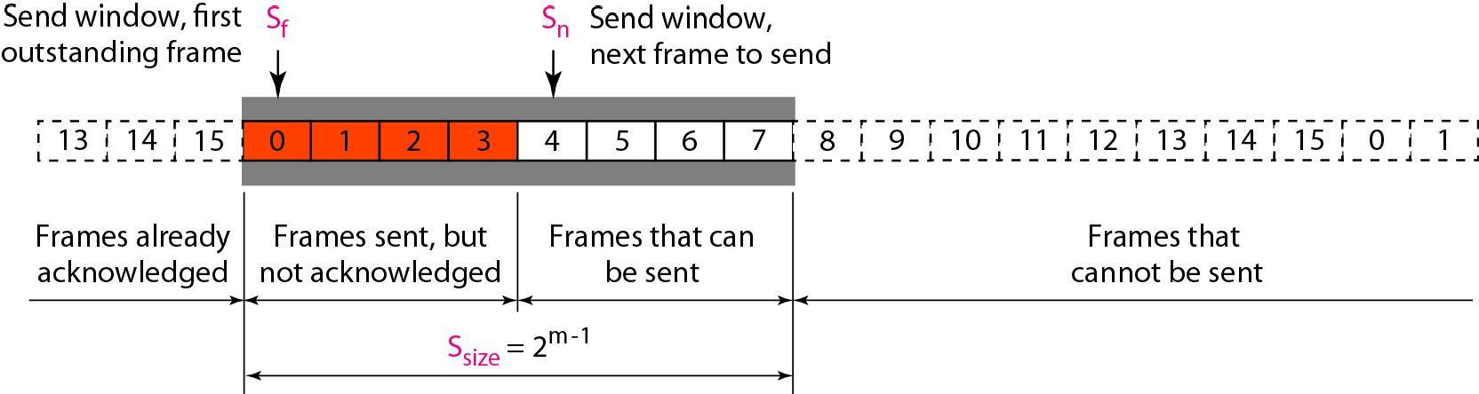
Figure 11.18 Send window for Selective Repeat ARQ
Stop-and-Wait ARQ is a special case of Go-Back-N ARQ in which the size of the send window is 1.

Slide 35
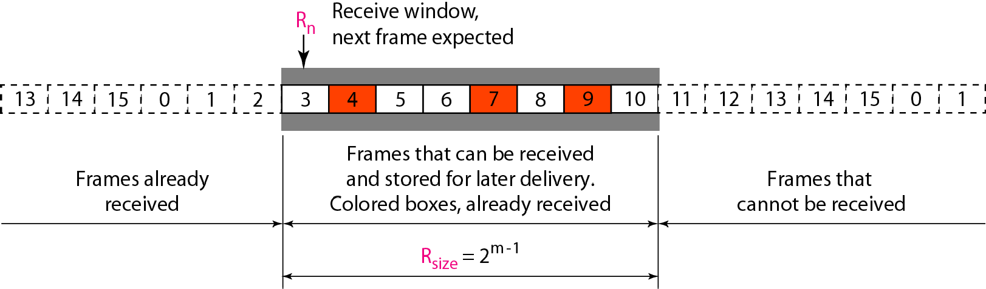
Figure 11.19 Receive window for Selective Repeat ARQ

Slide 36
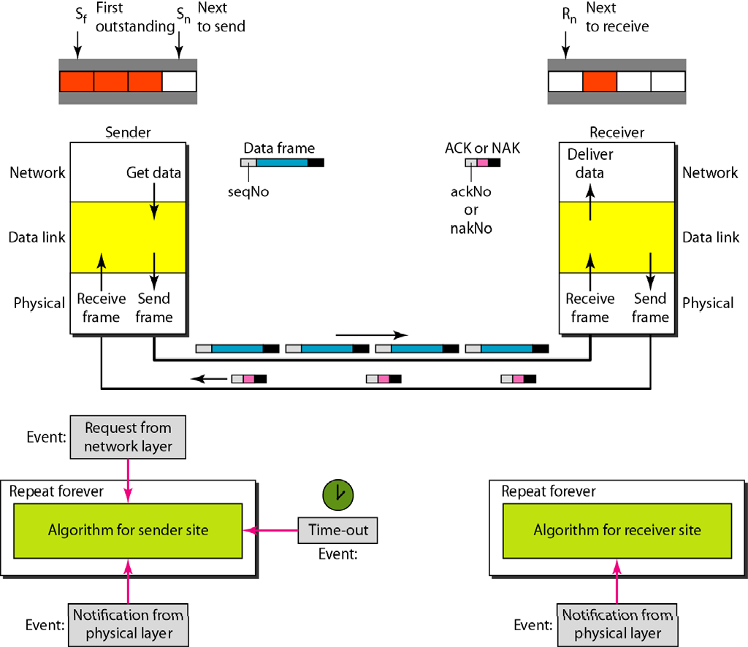
Figure 11.20 Design of Selective Repeat ARQ

Slide 37
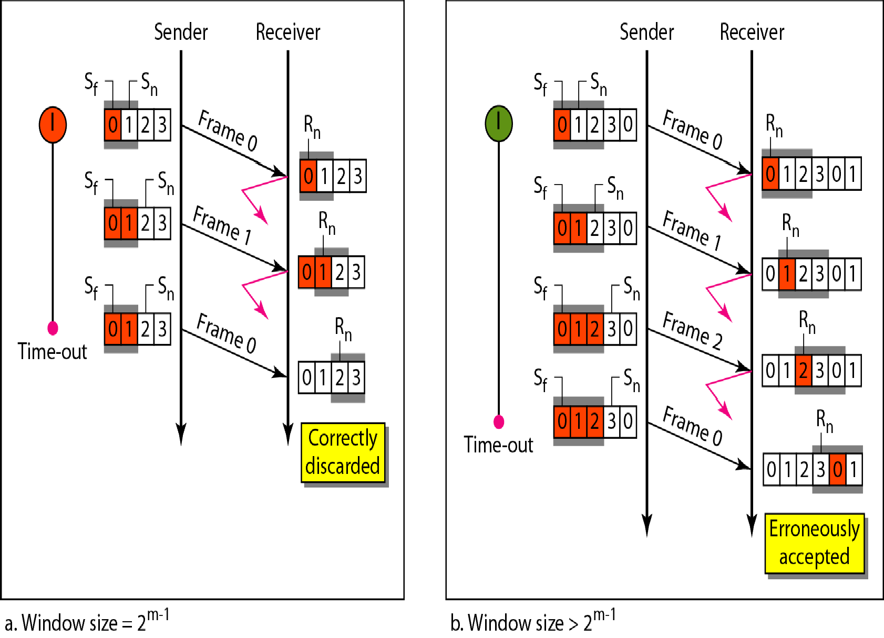
Figure 11.21 Selective Repeat ARQ, window size

Slide 38
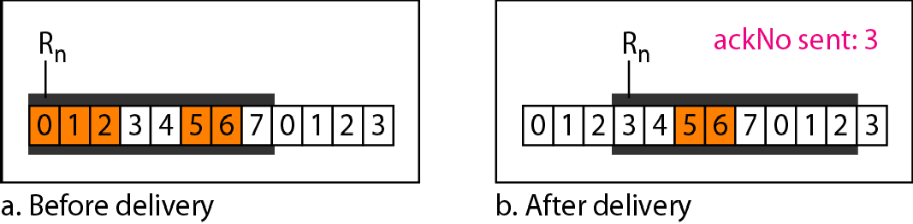
Figure 11.22 Delivery of data in Selective Repeat ARQ
In Selective Repeat ARQ, the size of the sender and receiver window
must be at most one-half of 2^{m}.

Slide 39
Example 11.8
This example is similar to Example 11.3 in which frame 1 is lost. We show how Selective Repeat behaves in this case. Figure 11.23 shows the situation. One main difference is the number of timers. Here, each frame sent or resent needs a timer, which means that the timers need to be numbered (0, 1, 2, and 3). The timer for frame 0 starts at the first request, but stops when the ACK for this frame arrives. The timer for frame 1 starts at the second request, restarts when a NAK arrives, and finally stops when the last ACK arrives. The other two timers start when the corresponding frames are sent and stop at the last arrival event.

Slide 40
Example 11.8 (continued)
At the receiver site we need to distinguish between the acceptance of a frame and its delivery to the network layer. At the second arrival, frame 2 arrives and is stored and marked, but it cannot be delivered because frame 1 is missing. At the next arrival, frame 3 arrives and is marked and stored, but still none of the frames can be delivered. Only at the last arrival, when finally a copy of frame 1 arrives, can frames 1, 2, and 3 be delivered to the network layer. There are two conditions for the delivery of frames to the network layer: First, a set of consecutive frames must have arrived. Second, the set starts from the beginning of the window.

Slide 41
Example 11.8 (continued)
Another important point is that a NAK is sent after the second arrival, but not after the third, although both situations look the same. The reason is that the protocol does not want to crowd the network with unnecessary NAKs and unnecessary resent frames. The second NAK would still be NAK1 to inform the sender to resend frame 1 again; this has already been done. The first NAK sent is remembered (using the nakSent variable) and is not sent again until the frame slides. A NAK is sent once for each window position and defines the first slot in the window.

Slide 42
Example 11.8 (continued)
The next point is about the ACKs. Notice that only two ACKs are sent here. The first one acknowledges only the first frame; the second one acknowledges three frames. In Selective Repeat, ACKs are sent when data are delivered to the network layer. If the data belonging to n frames are delivered in one shot, only one ACK is sent for all of them.

Slide 43
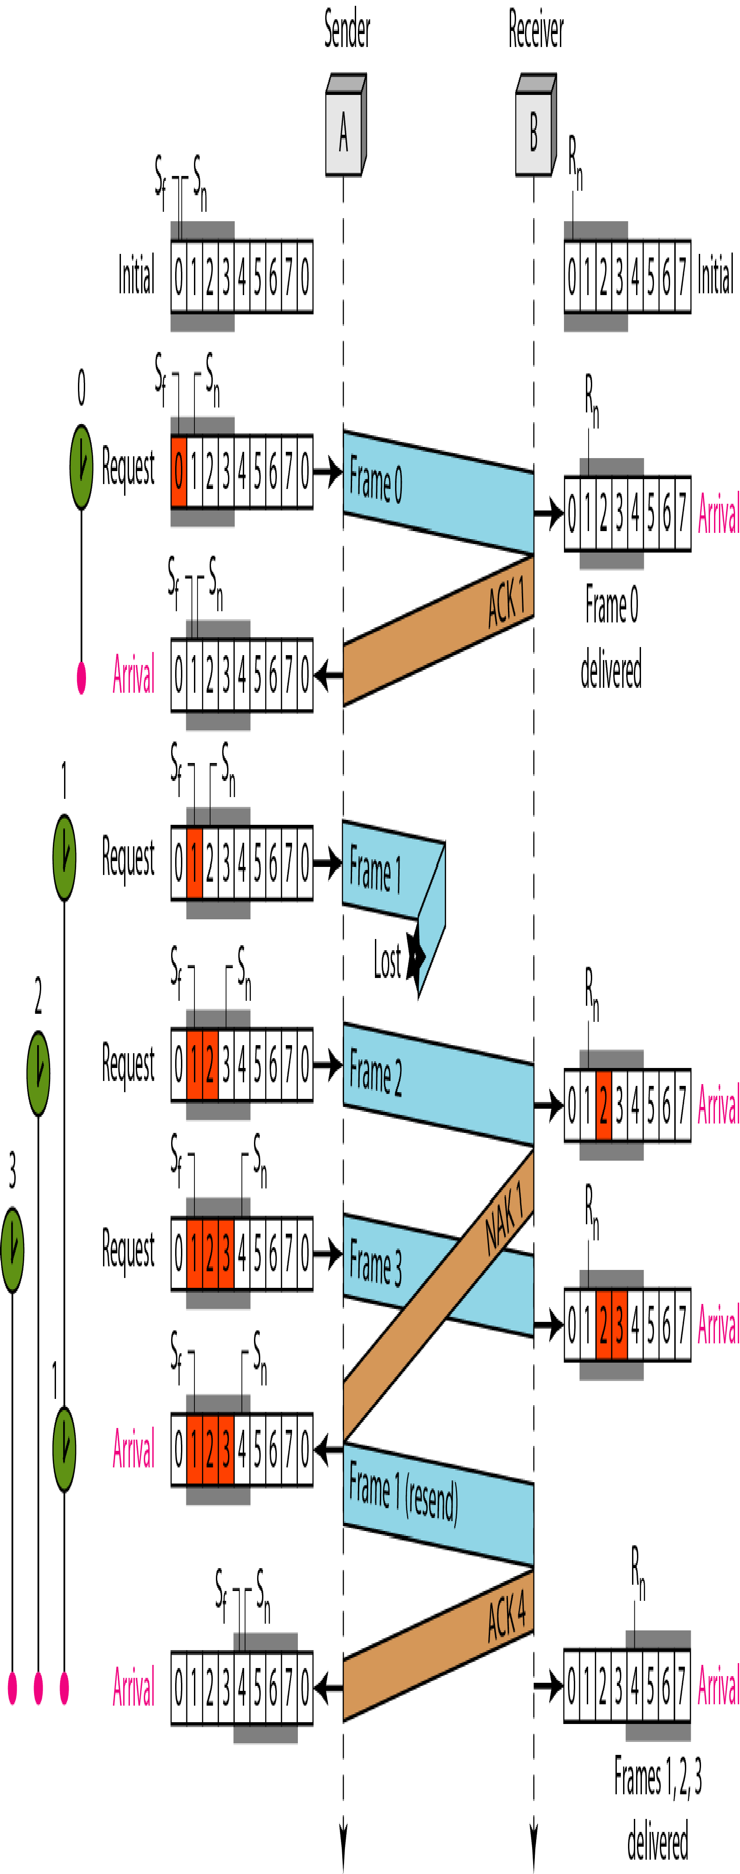
Figure 11.23 Flow diagram for Example 11.8

Slide 44
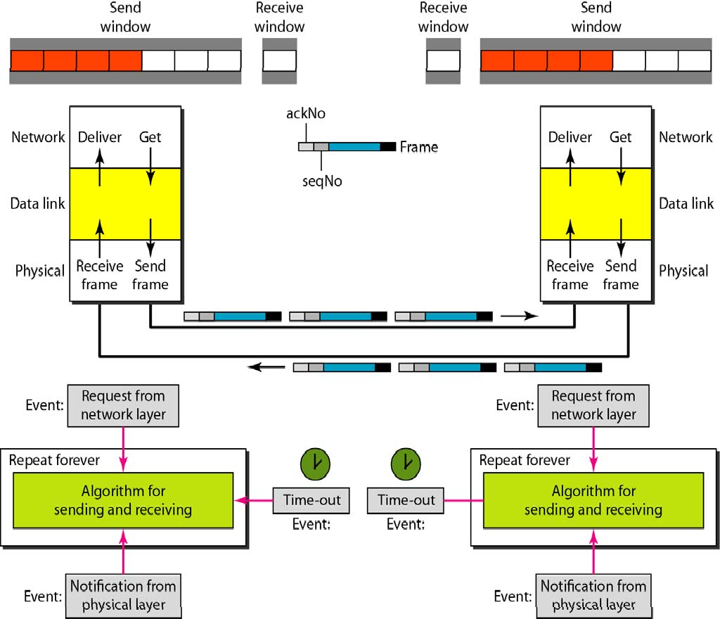
Figure 11.24 Design of piggybacking in Go-Back-N ARQ

Slide 45
11-6 HDLC
High-level Data Link Control (HDLC) is a bit-oriented protocol for communication over point-to-point and multipoint links.. It implements the ARQ mechanisms we discussed in this chapter.
Topics discussed in this section: Configurations and Transfer Modes Frames
Control Field

Slide 46
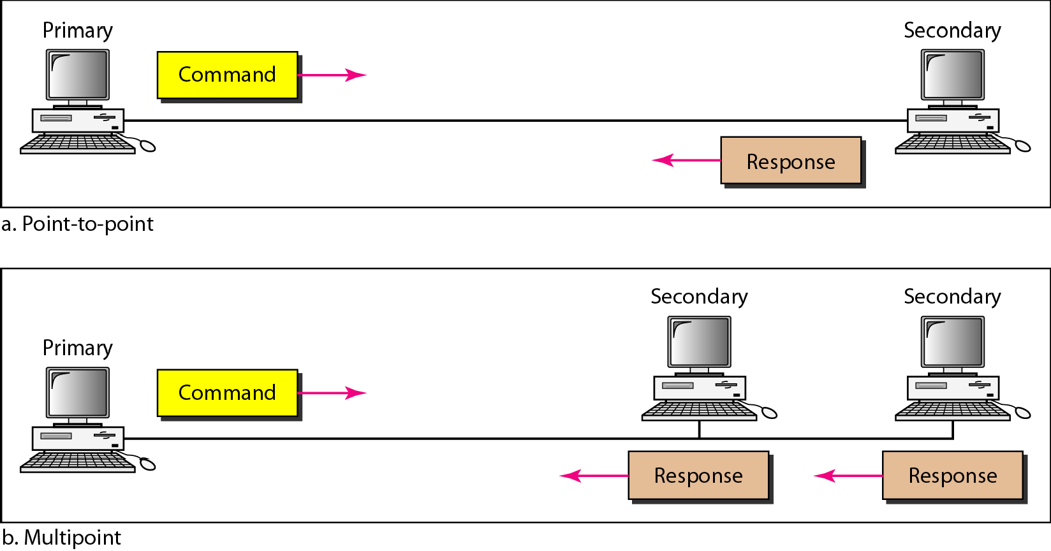
Figure 11.25 Normal response mode

Slide 47
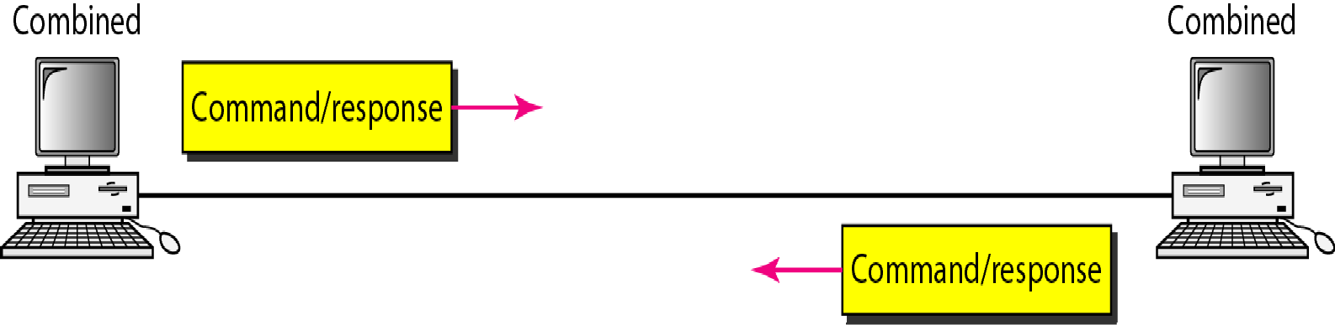
Figure 11.26 Asynchronous balanced mode

Slide 48
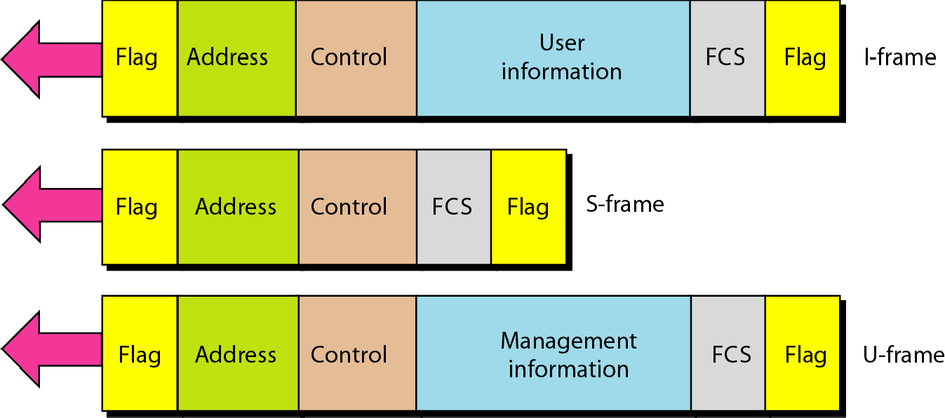
Figure 11.27 HDLC frames

Slide 49
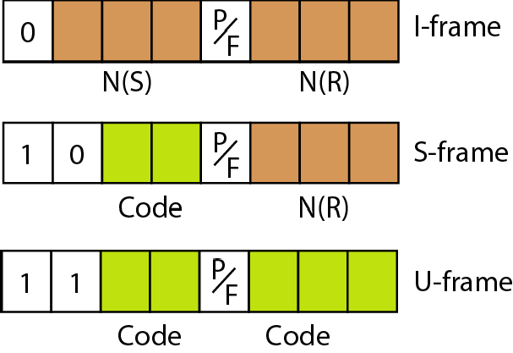
Figure 11.28 Control field format for the different frame types

Slide 50
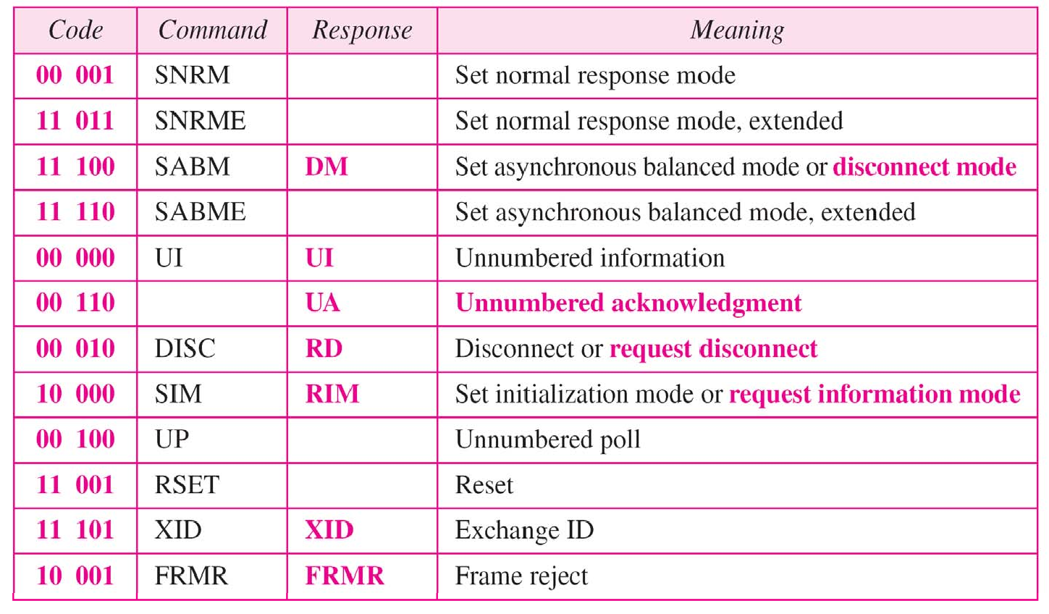
Table 11.1 U-frame control command and response

Slide 51
Example 11.9
Figure 11.29 shows how U-frames can be used for connection establishment and connection release. Node A asks for a connection with a set asynchronous balanced mode (SABM) frame; node B gives a positive response with an unnumbered acknowledgment (UA) frame. After these two exchanges, data can be transferred between the two nodes (not shown in the figure). After data transfer, node A sends a DISC (disconnect) frame to release the connection; it is confirmed by node B responding with a UA (unnumbered acknowledgment).

Slide 52
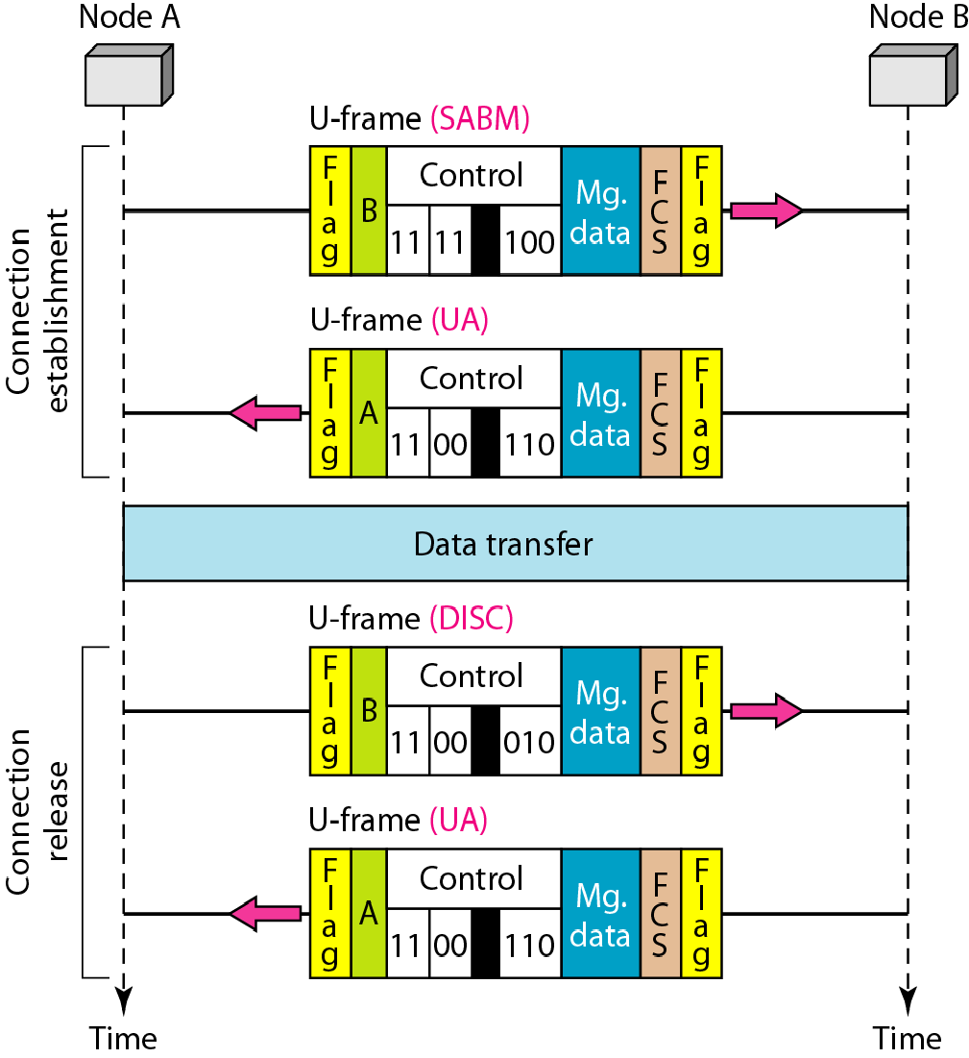
Figure 11.29 Example of connection and disconnection

Slide 53
Example 11.10
Figure 11.30 shows an exchange using piggybacking. Node A begins the exchange of information with an I-frame numbered 0 followed by another I-frame numbered 1. Node B piggybacks its acknowledgment of both frames onto an I-frame of its own. Node B’s first I-frame is also numbered 0 [N(S) field] and contains a 2 in its N(R) field, acknowledging the receipt of A’s frames 1 and 0 and indicating that it expects frame 2 to arrive next. Node B transmits its second and third I-frames (numbered 1 and 2) before accepting further frames from node A.

Slide 54
Example 11.10 (continued)
Its N(R) information, therefore, has not changed: B frames 1 and 2 indicate that node B is still expecting A’s frame 2 to arrive next. Node A has sent all its data. Therefore, it cannot piggyback an acknowledgment onto an I-frame and sends an S-frame instead. The RR code indicates that A is still ready to receive. The number 3 in the N(R) field tells B that frames 0, 1, and 2 have all been accepted and that A is now expecting frame number 3.

Slide 55
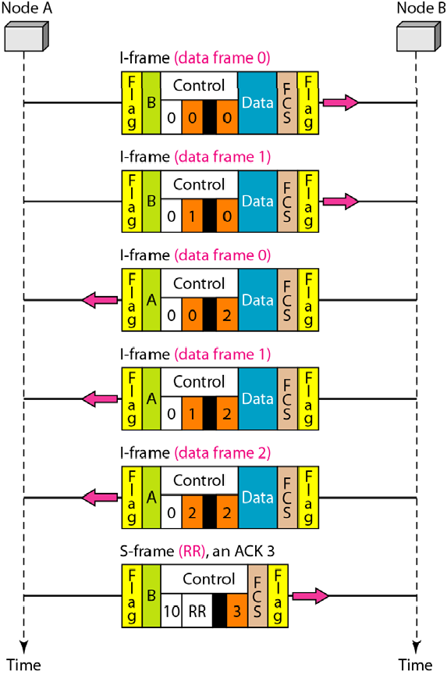
Figure 11.30 Example of piggybacking without error

Slide 56
Example 11.11
Figure 11.31 shows an exchange in which a frame is lost. Node B sends three data frames (0, 1, and 2), but frame 1 is lost. When node A receives frame 2, it discards it and sends a REJ frame for frame 1. Note that the protocol being used is Go-Back-N with the special use of an REJ frame as a NAK frame. The NAK frame does two things here: It confirms the receipt of frame 0 and declares that frame 1 and any following frames must be resent. Node B, after receiving the REJ frame, resends frames 1 and 2. Node A acknowledges the receipt by sending an RR frame (ACK) with acknowledgment number 3.

Slide 57
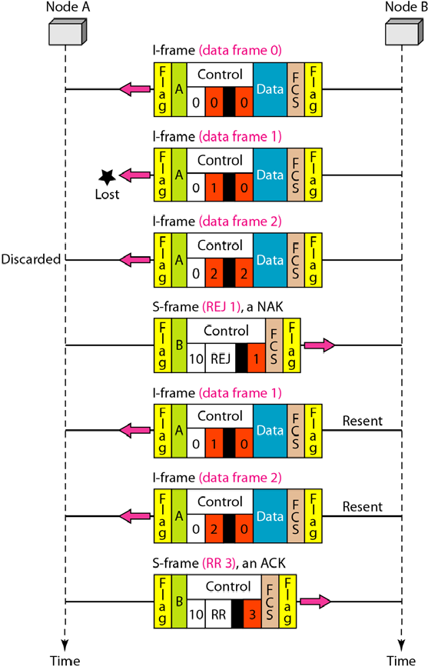
Figure 11.31 Example of piggybacking with error

Slide 58
11-7 POINT-TO-POINT PROTOCOL
Although HDLC is a general protocol that can be used for both point-to-point and multipoint configurations, one of the most common protocols for point-to-point access is the Point-to-Point Protocol (PPP). PPP is a byte-oriented protocol..
Topics discussed in this section:
Framing Transition Phases Multiplexing Multilink PPP

Slide 59
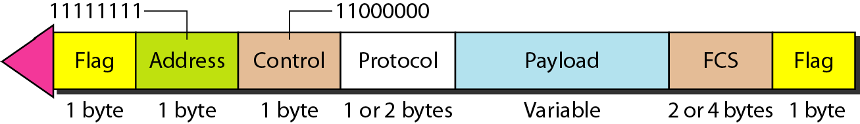
Figure 11.32 PPP frame format
PPP is a byte-oriented protocol using byte stuffing with the escape byte 01111101.

Slide 60
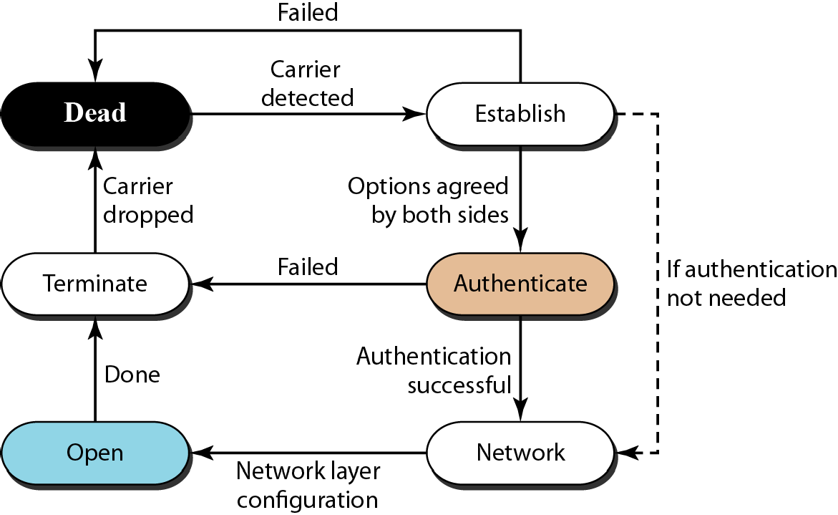
Figure 11.33 Transition phases

Slide 61
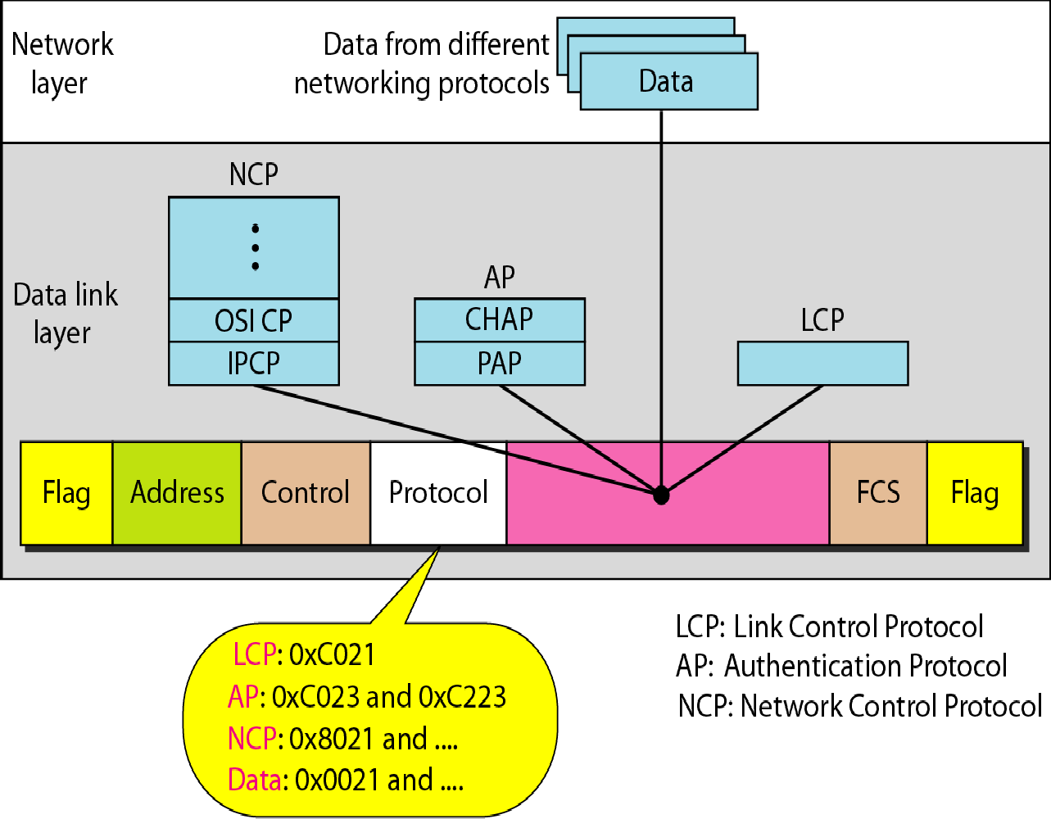
Figure 11.34 Multiplexing in PPP

Slide 62
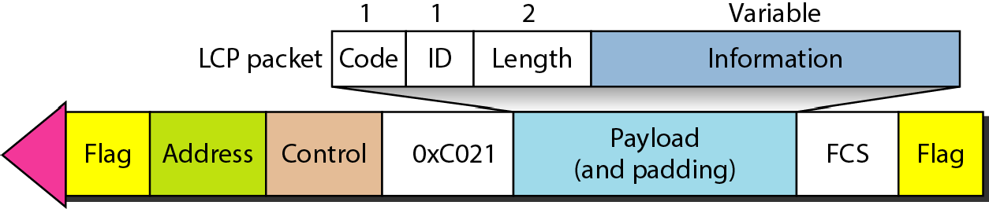
Figure 11.35 LCP packet encapsulated in a frame

Slide 63
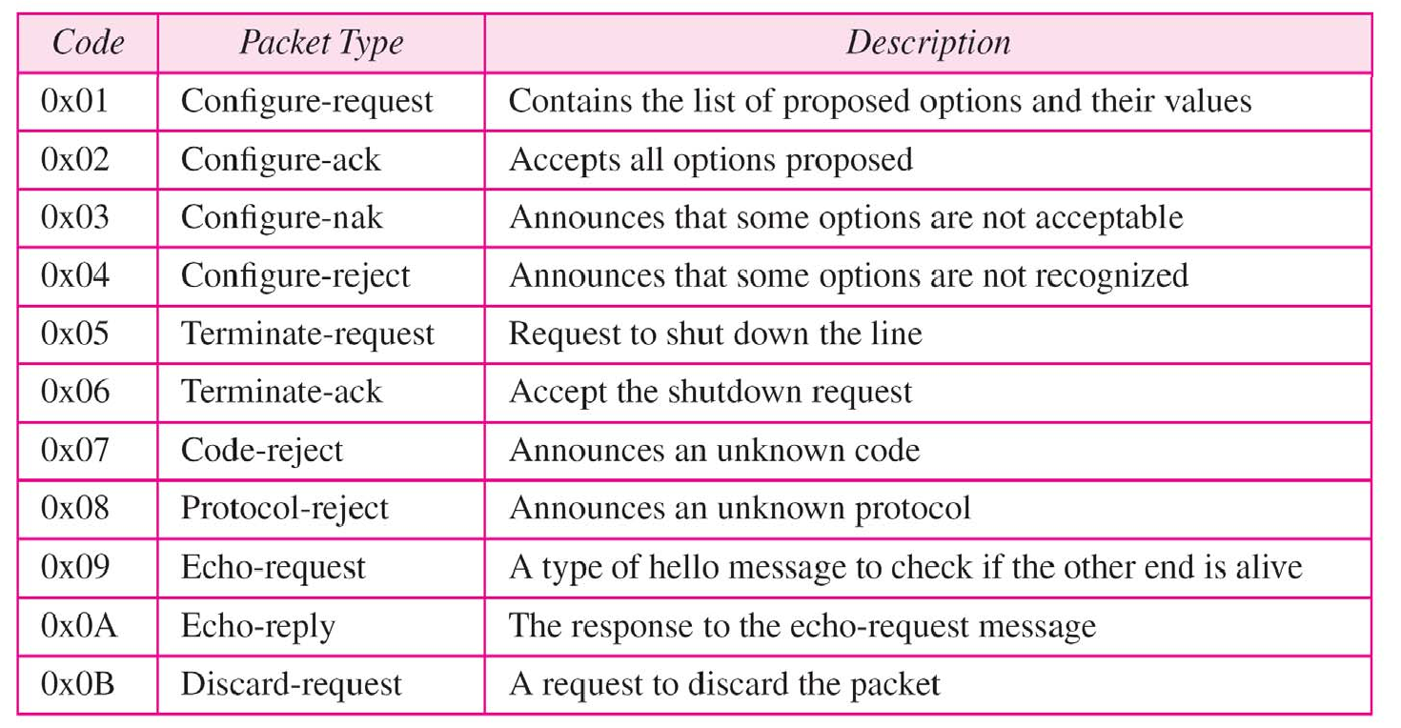
Table 11.2 LCP packets

Slide 64
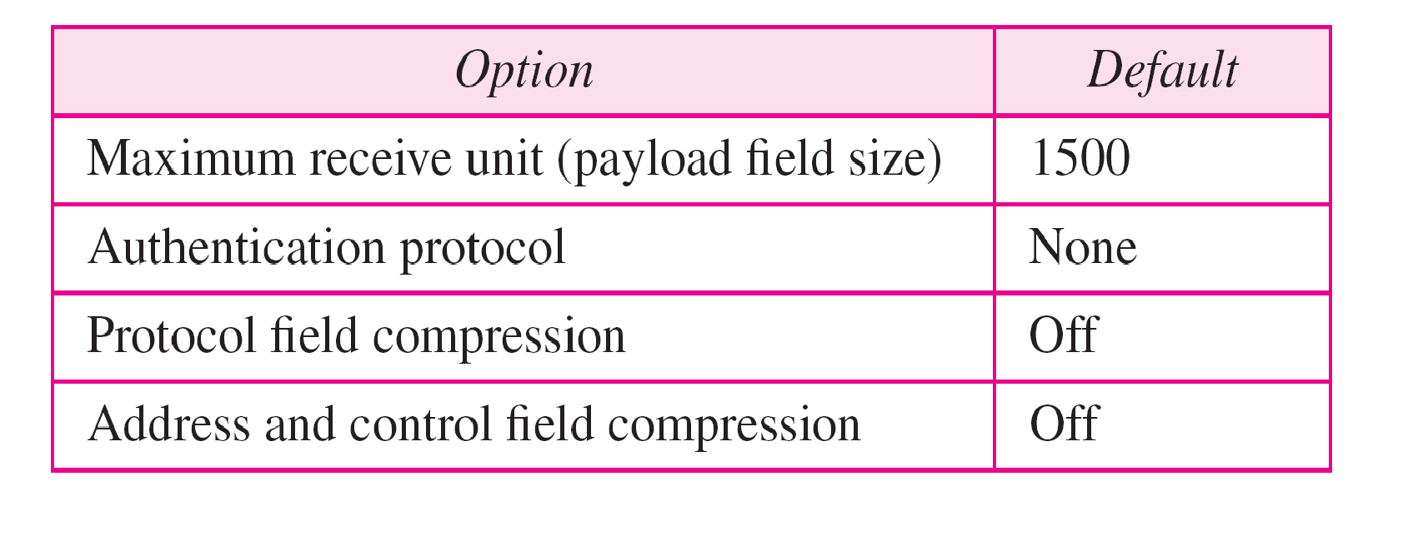
Table 11.3 Common options

Slide 65
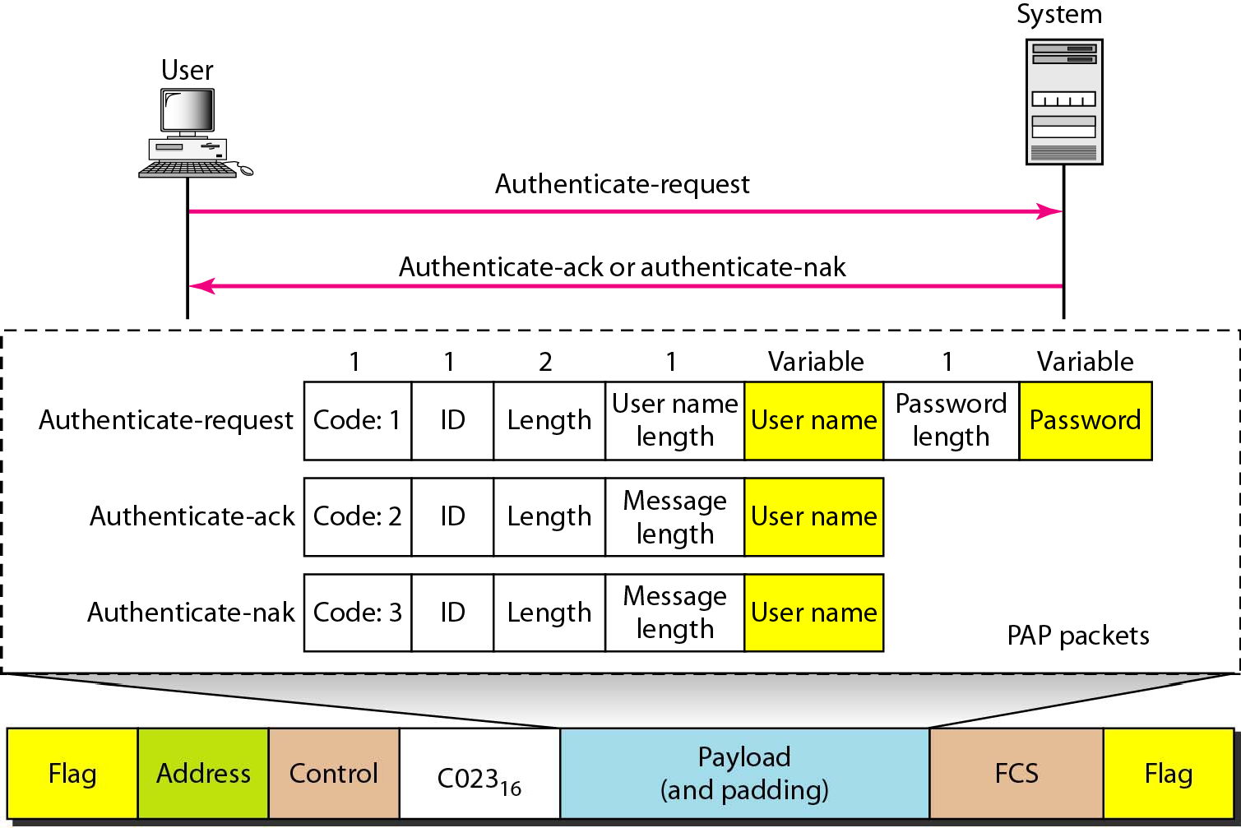
Figure 11.36 PAP packets encapsulated in a PPP frame

Slide 66
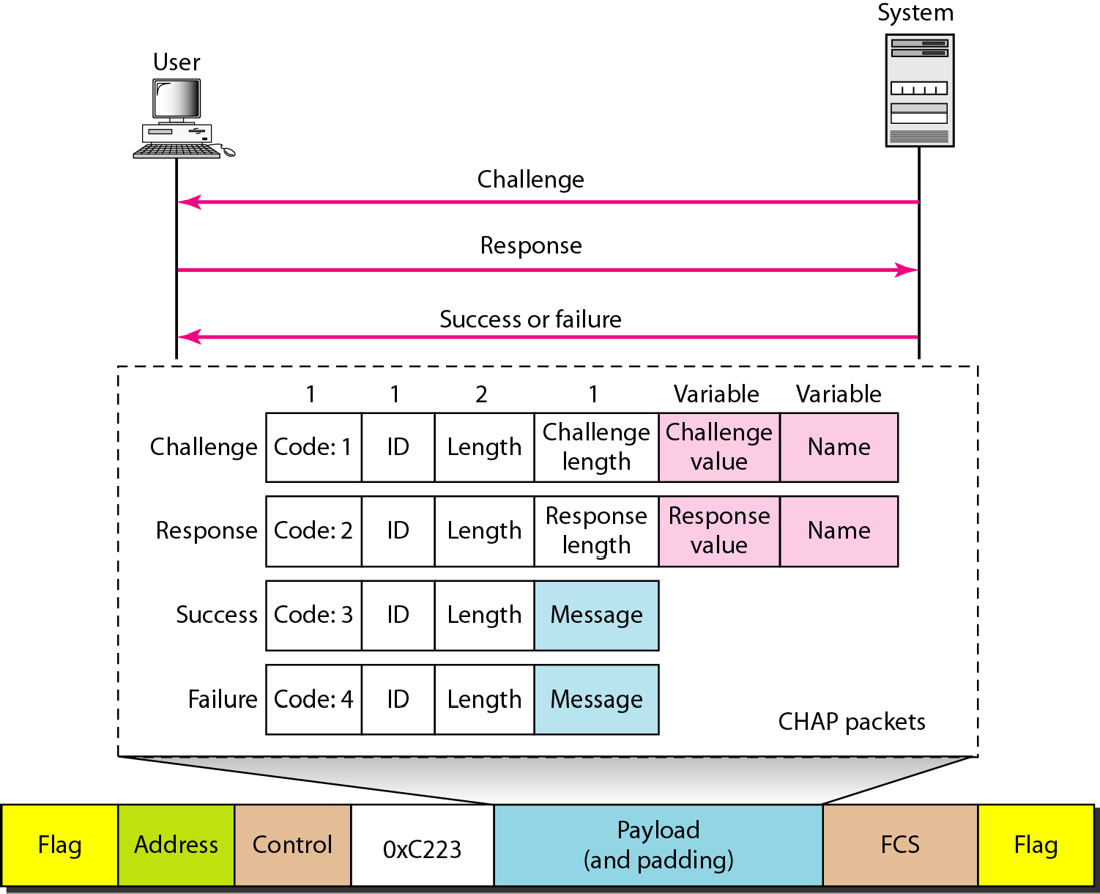
Figure 11.37 CHAP packets encapsulated in a PPP frame

Slide 67
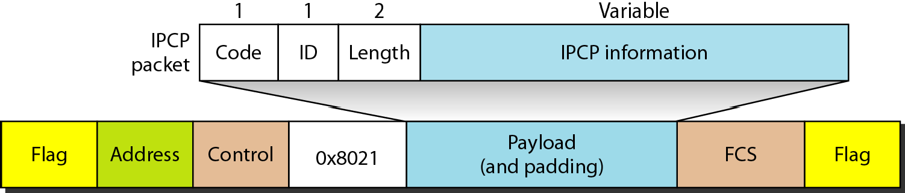
Figure 11.38 IPCP packet encapsulated in PPP frame

Slide 68
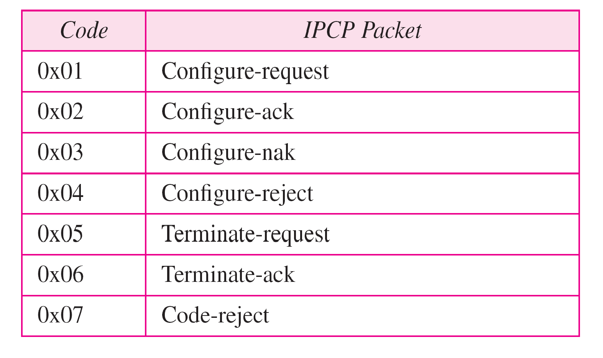
Table 11.4 Code value for IPCP packets

Slide 69
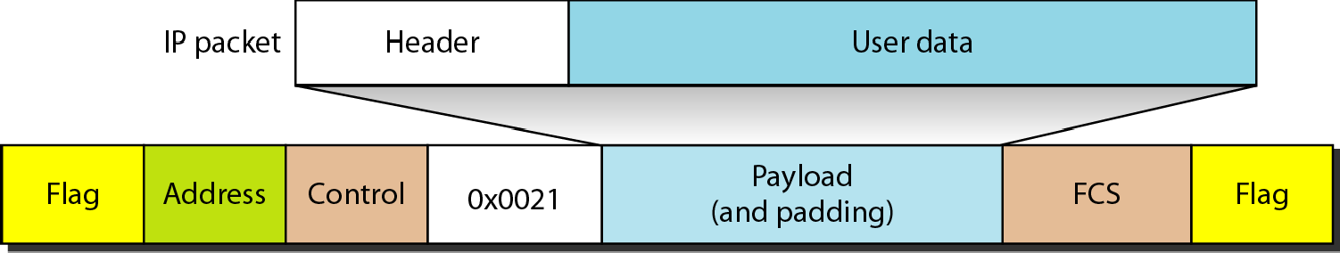
Figure 11.39 IP datagram encapsulated in a PPP frame

Slide 70
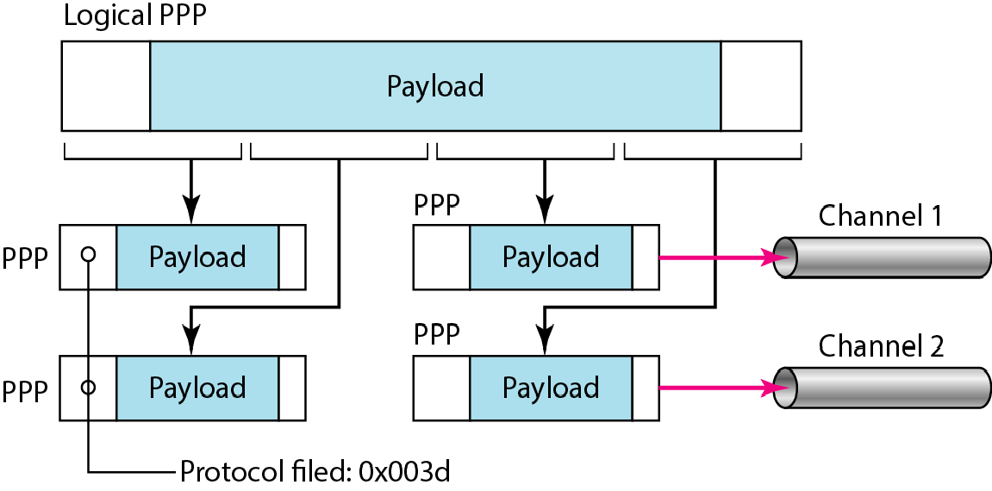
Figure 11.40 Multilink PPP

Slide 71
Example 11.12
Let us go through the phases followed by a network layer packet as it is transmitted through a PPP connection. Figure 11.41 shows the steps. For simplicity, we assume unidirectional movement of data from the user site to the system site (such as sending an e-mail through an ISP).
The first two frames show link establishment. We have chosen two options (not shown in the figure): using PAP for authentication and suppressing the address control fields. Frames 3 and 4 are for authentication. Frames 5 and 6 establish the network layer connection using IPCP.
11.71

Slide 72
Example 11.12 (continued)
The next several frames show that some IP packets are encapsulated in the PPP frame. The system (receiver) may have been running several network layer protocols, but it knows that the incoming data must be delivered to the IP protocol because the NCP protocol used before the data transfer was IPCP.
After data transfer, the user then terminates the data link connection, which is acknowledged by the system. Of course the user or the system could have chosen to terminate the network layer IPCP and keep the data link layer running if it wanted to run another NCP protocol.
11.72

Slide 73
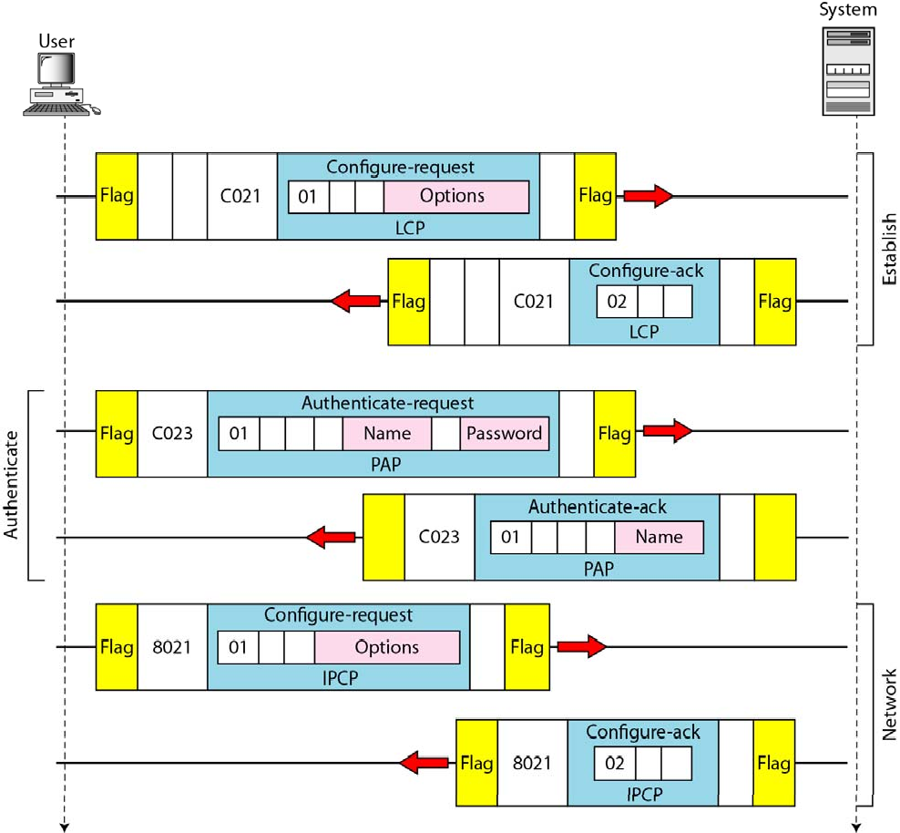
Figure 11.41 An example
11.73

Slide 74
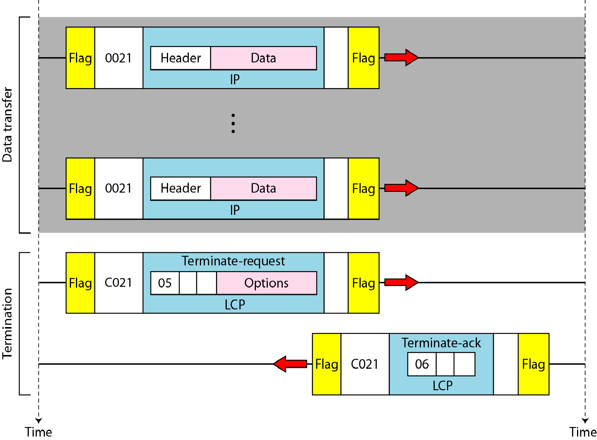
Figure 11.41 An example (continued)
11.74

Slide 75
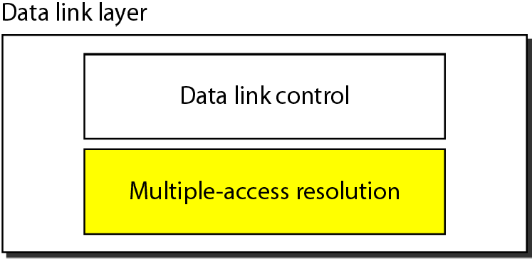
Figure 12.1 Data link layer divided into two functionality-oriented sublayers
12.75

Slide 76
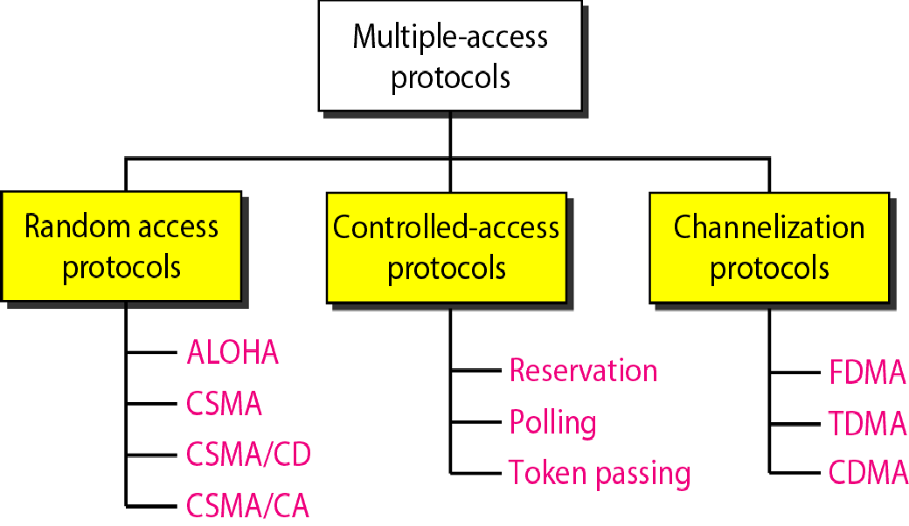
Figure 12.2 Taxonomy of multiple-access protocols discussed in this chapter
12.76

Slide 77
12-1 RANDOM ACCESS
In random access or contention methods, no station is superior to another station and none is assigned the control over another. No station permits, or does not permit, another station to send.. At each instance, a station that has data to send uses a procedure defined by the protocol to make a decision on whether or not to send.
Topics discussed in this section:
ALOHA
Carrier Sense Multiple Access
Carrier Sense Multiple Access with Collision Detection Carrier Sense Multiple Access with Collision Avoidance
12.77

Slide 78
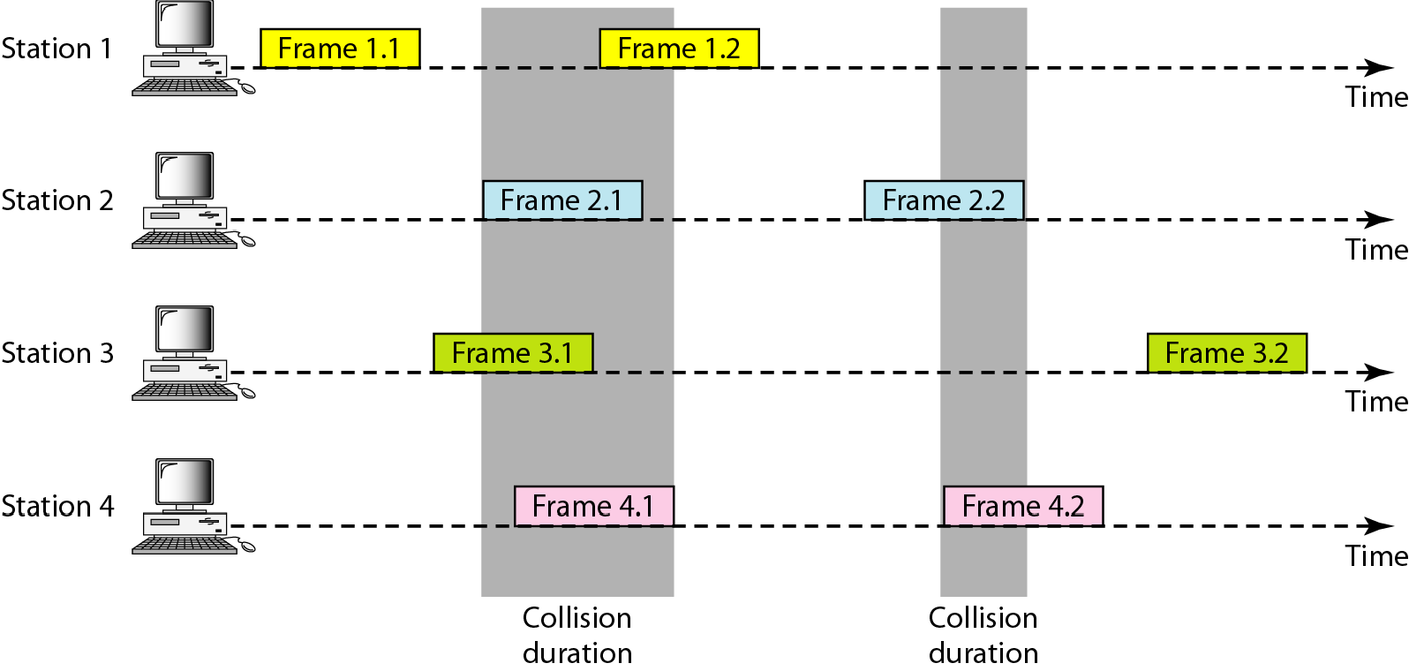
Figure 12.3 Frames in a pure ALOHA network
12.78

Slide 79
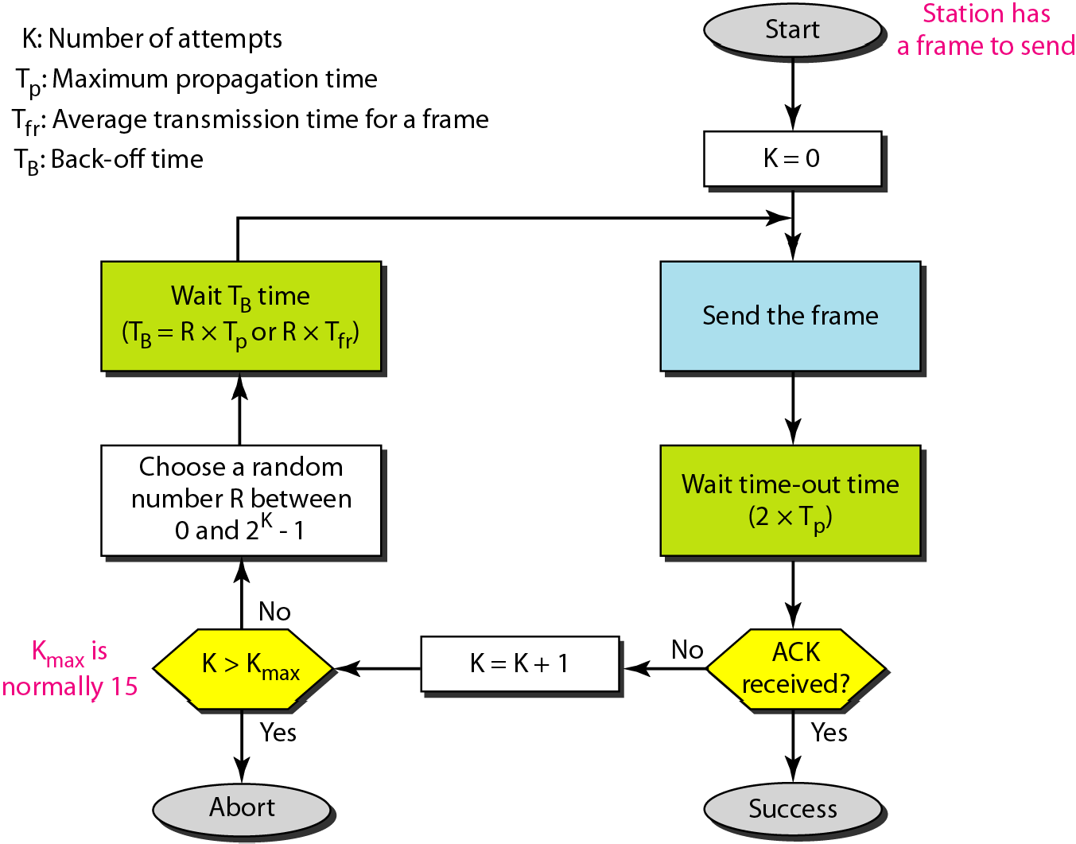
Figure 12.4 Procedure for pure ALOHA protocol
12.79

Slide 80
Example 12.1
The stations on a wireless ALOHA network are a maximum of 600 km apart. If we assume that signals propagate at 3 × 10⁸ m/s, we find
Tp = (600 × 10⁵ ) / (3 × 10⁸ ) = 2 ms.
Now we can find the value of T_{B} for different values of K .
a. For K = 1, the range is {0, 1}. The station needs to| generate a random number with a value of 0 or 1. This means that T_{B} is either 0 ms (0 × 2) or 2 ms (1 × 2), based on the outcome of the random variable.
12.80

Slide 81
Example 12.1 (continued)
b. For K = 2, the range is {0, 1, 2, 3}. This means that T_{B} can be 0, 2, 4, or 6 ms, based on the outcome of the random variable.
c. For K = 3, the range is {0, 1, 2, 3, 4, 5, 6, 7}. This means that T_{B} can be 0, 2, 4, . . . , 14 ms, based on the outcome of the random variable.
d. We need to mention that if K > 10, it is normally set to 10.
12.81

Slide 82

Figure 12.5 Vulnerable time for pure ALOHA protocol
12.82

Slide 83
Example 12.2
A pure ALOHA network transmits 200-bit frames on a shared channel of 200 kbps. What is the requirement to make this frame collision-free?
Solution
Average frame transmission time T_{fr} is 200 bits/200 kbps or 1 ms. The vulnerable time is 2 × 1 ms = 2 ms. This means no station should send later than 1 ms before this station starts transmission and no station should start sending during the one 1-ms period that this station is sending.

Slide 84

Note
The throughput for pure ALOHA is S = G × e ^{−2G} .
The maximum throughput S_{max} = 0.184 when G= (1/2).

Slide 85
Example 12.3
A pure ALOHA network transmits 200-bit frames on a shared channel of 200 kbps. What is the throughput if the system (all stations together) produces
a. 1000 frames per second
c. 250 frames per second.
Solution
b. 500 frames per second
The frame transmission time is 200/200 kbps or 1 ms.
a. If the system creates 1000 frames per second, this is 1 frame per millisecond. The load is 1. In this case S = G× e^{−2 G} or S = 0.135 (13.5 percent). This means that the throughput is 1000 × 0.135 = 135 frames. Only 135 frames out of 1000 will probably survive.

Slide 86
Example 12.3 (continued)
b. If the system creates 500 frames per second, this is (1/2) frame per millisecond. The load is (1/2). In this case S = G × e ^{−2G} or S = 0.184 (18.4 percent). This means that the throughput is 500 × 0.184 = 92 and that only 92 frames out of 500 will probably survive. Note that this is the maximum throughput case, percentagewise.
c. If the system creates 250 frames per second, this is (1/4) frame per millisecond. The load is (1/4). In this case S = G × e −^{2G} or S = 0.152 (15.2 percent). This means that the throughput is 250 × 0.152 = 38. Only 38 frames out of 250 will probably survive.

Slide 87

Figure 12.6 Frames in a slotted ALOHA network

Slide 88
Note
The throughput for slotted ALOHA is S = G × e^{−G} .
The maximum throughput S_{max} = 0.368 when G = 1.

Slide 89

Figure 12.7 Vulnerable time for slotted ALOHA protocol

Slide 90
Example 12.4
A slotted ALOHA network transmits 200-bit frames on a shared channel of 200 kbps. What is the throughput if the system (all stations together) produces
a. 1000 frames per second
c. 250 frames per second.
Solution
b. 500 frames per second
The frame transmission time is 200/200 kbps or 1 ms.
a. If the system creates 1000 frames per second, this is 1 frame per millisecond. The load is 1. In this case S = G× e^{−G} or S = 0.368 (36.8 percent). This means that the throughput is 1000 × 0.0368 = 368 frames. Only 386 frames out of 1000 will probably survive.

Slide 91
Example 12.4 (continued)
b. If the system creates 500 frames per second, this is (1/2) frame per millisecond. The load is (1/2). In this case S = G × e^{−G} or S = 0.303 (30.3 percent). This means that the throughput is 500 × 0.0303 = 151. Only 151 frames out of 500 will probably survive.
c. If the system creates 250 frames per second, this is (1/4) frame per millisecond. The load is (1/4). In this case S = G × e ^{−G} or S = 0.195 (19.5 percent). This means that the throughput is 250 × 0.195 = 49. Only 49 frames out of 250 will probably survive.

Slide 92

Figure 12.8 Space/time model of the collision in CSMA

Slide 93

Figure 12.9 Vulnerable time in CSMA

Slide 94

Figure 12.10 Behavior of three persistence methods

Slide 95

Figure 12.11 Flow diagram for three persistence methods

Slide 96

Figure 12.12 Collision of the first bit in CSMA/CD

Slide 97

Figure 12.13 Collision and abortion in CSMA/CD

Slide 98
Example 12.5
A network using CSMA/CD has a bandwidth of 10 Mbps. If the maximum propagation time (including the delays in the devices and ignoring the time needed to send a jamming signal, as we see later) is 25 6 μs, what is the minimum size of the frame?
Solution
The frame transmission time is T_{fr} = 2 × T_{p} = 51.2 μs. This means, in the worst case, a station needs to transmit for a period of 51.2 μs to detect the collision. The minimum size of the frame is 10 Mbps × 51.2 μs = 512 bits or 64 bytes. This is actually the minimum size of the frame for Standard Ethernet.

Slide 99

Figure 12.14 Flow diagram for the CSMA/CD

Slide 100

Figure 12.15 Energy level during transmission, idleness, or collision

Slide 101

Figure 12.16 Timing in CSMA/CA
In CSMA/CA, the IFS can also be used to define the priority of a station or a frame.

Slide 102
Note
In CSMA/CA, if the station finds the channel busy, it does not restart the timer of the contention window;
it stops the timer and restarts it when the channel becomes idle.

Slide 103

Figure 12.17 Flow diagram for CSMA/CA

Slide 104
12-2 CONTROLLED ACCESS
In controlled access,, the stations consult one another to find which station has the right to send. A station cannot send unless it has been authorized by other stations. We discuss three popular controlled-access methods..
Topics discussed in this section:
Reservation Polling
Token Passing

Slide 105

Figure 12.18 Reservation access method

Slide 106

Figure 12.19 Select and poll functions in polling access method

Slide 107

Figure 12.20 Logical ring and physical topology in token-passing access method

Slide 108
12-3 CHANNELIZATION
Channelization is a multiple-access method in which the available bandwidth of a link is shared in time, frequency, or through code, between different stations.. In this section, we discuss three channelization protocols..
Topics discussed in this section: Frequency-Division Multiple Access (FDMA) Time-Division Multiple Access (TDMA) Code-Division Multiple Access (CDMA)

Slide 109

Figure 12.21 Frequency-division multiple access (FDMA)

Slide 110
Note
In FDMA, the available bandwidth of the common channel is divided into
bands that are separated by guard bands.

Slide 111

Figure 12.22 Time-division multiple access (TDMA)

Slide 112
In TDMA, the bandwidth is just one channel that is timeshared between different stations.
In CDMA, one channel carries all transmissions simultaneously.

Slide 113

Figure 12.23 Simple idea of communication with code

Slide 114
Figure 12.24 Chip sequences
Figure 12.25 Data representation in CDMA

Slide 115

Figure 12.26 Sharing channel in CDMA

Slide 116

Figure 12.27 Digital signal created by four stations in CDMA

Slide 117

Figure 12.28 Decoding of the composite signal for one in CDMA

Slide 118

Figure 12.29 General rule and examples of creating Walsh tables

Slide 119
Example 12.6
The number of sequences in a Walsh table needs to be N = 2^{m}.
Find the chips for a network with
a. Two stations b. Four stations
Solution
We can use the rows of W2 and W4 in Figure 12.29:
For a two-station network, we have
[+1 +1] and [+1 −1].
For a four-station network we have
[+1 +1 +1 +1], [+1 −1 +1 −1],
[+1 +1 −1 −1], and [+1 −1 −1 +1].

Slide 120
Example 12.7
What is the number of sequences if we have 90 stations in our network?
Solution
The number of sequences needs to be 2^{m}. We need to choose m = 7 and N = 2⁷ or 128. We can then use 90 of the sequences as the chips.

Slide 121
Example 12.8
Prove that a receiving station can get the data sent by a specific sender if it multiplies the entire data on the channel by the sender’s chip code and then divides it by the number of stations.
Solution
Let us prove this for the first station, using our previous four-station example. We can say that the data on the channel
D = (d1 c1 + d2 c2 + d3 c3 + d4 c4). The receiver which wants to get the data sent by station 1 multiplies these data by c1.

Slide 122

Example 12.8 (continued)
When we divide the result by N, we get d1 .

